Slide 1
Sketch a Sturgeon

Slide 2
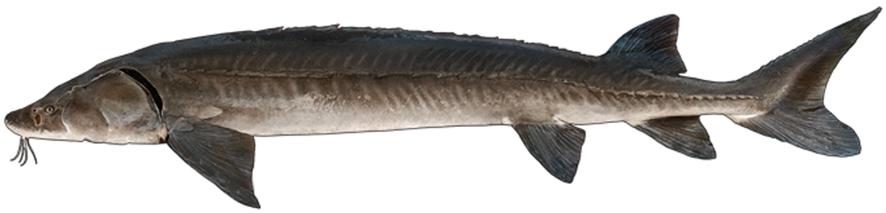
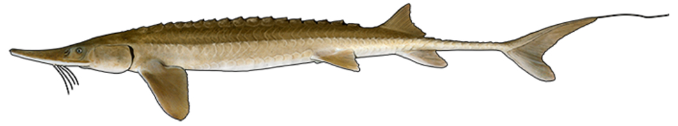
Sturgeon Species Found in Wisconsin
Lake sturgeon
Acipenser fulvescens
Shovelnose sturgeon
Scaphirhynchus platorynchus
Credit: WI DNR
Notes:
There are two sturgeon species found in Wisconsin: the lake sturgeon and the shovelnose sturgeon. What do you notice from these lateral perspectives? Shape? Key features? How is one species similar to and different from the other? Select a sturgeon species to draw and write down observations related to the overall body shape on your note-taking handout.

Slide 3
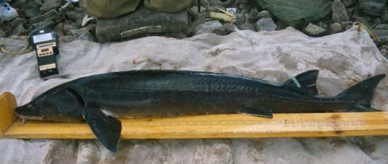
Lake Sturgeon Length
Photo: John Lyons
Notes:
The size of a sturgeon has two key elements: length and girth. Length is the distance from the tip of the snout to the tip of the tail.

Slide 4
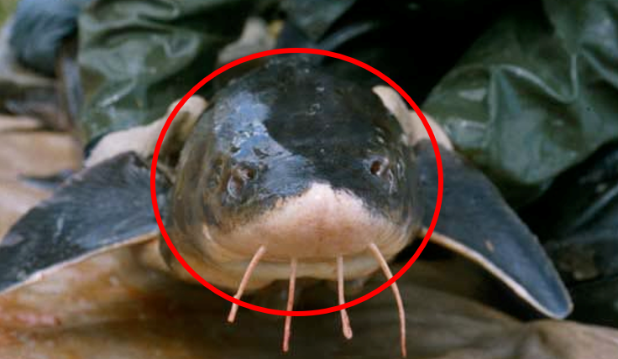
Lake Sturgeon Girth
Photo: John Lyons
Notes:
Girth is the width around the body at the widest place. It’s difficult to see on a 2D representation of a fish, but this slide shows the width of the fish.

Slide 5
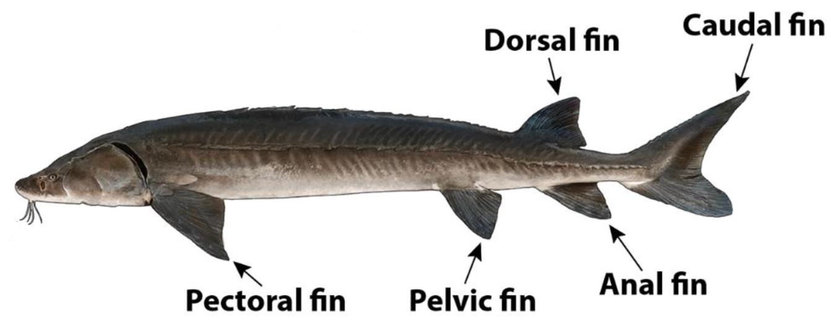
Fins of a Lake Sturgeon
Credit: WI DNR
Notes:
Note the five types of fins seen in this lateral view line drawing. The dorsal and anal fins are used to stabilize the fish. Pectoral and pelvic fins are on the sides of the body, and they are used for turning, backing up, stopping, and balancing. The caudal or tail fin is like a boat propeller; it pushes the fish through the water by moving back and forth. The caudal fin on sturgeon is asymmetrical – a trait it shares with sharks. For each fin type, write your observations related to the number of each fin type, their relative shape, size, and position on the body on your handout.

Slide 6
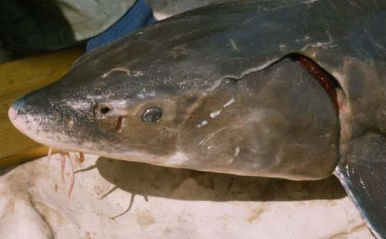
The Head of a Lake Sturgeon
Photo: John Lyons
Notes:
What do you observe in this photo taken from a lateral perspective of the head of a sturgeon that might be missing from your notes? Write down any additional observations. Hint: You may want to note the number and type of organs the sturgeon uses for sensing the world around it.

Slide 7
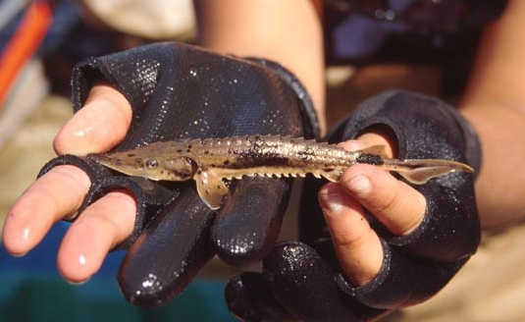
Juvenile Lake Sturgeon
Photo: John Lyons
Notes:
This juvenile lake sturgeon image shows an interesting feature of the lake sturgeon: their scutes. Do you remember what their function is? (Scutes can help serve as protection for the fish – like armor.) Write down on your “My Sturgeon Notes” handout your additional observations about scutes. Hint: You may want to note how many and the location of the rows of scutes. Also, notice the color pattern. How is it different from the adult fish?

Slide 8
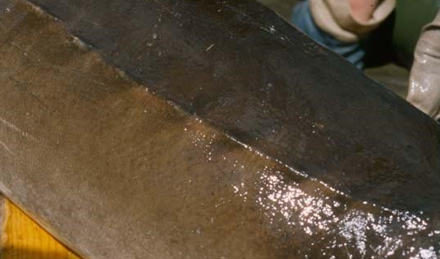
Scutes on an Adult Lake Sturgeon
Photo: John Lyons
Notes:
On page 9 in “Saving Our Sturgeon,” the author states, “A young sturgeon’s scutes have points that are sharp enough to cut your hand, but they wear down and stretch out with age until they just look like rounded bumps on their skin.” Based on this statement, do you think the lake sturgeon portrayed in this image is intended to represent a young sturgeon? Why or why not?

Slide 9
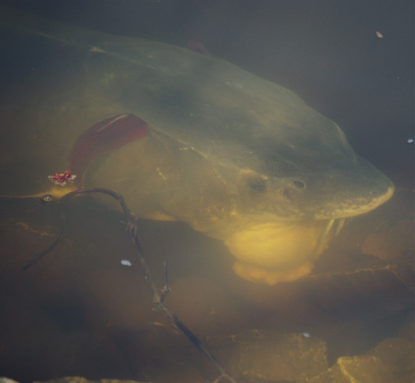
Mouth of a Lake Sturgeon
Photo: Titus Seilheimer
Notes:
This photo is taken from the side of the sturgeon. At the right edge of the photograph is the sturgeon’s head and mouth. Because the picture is an underwater photograph, details may be a bit harder to distinguish. Teacher note: If students are wondering – the larger red crescent in the photo is the gills of the sturgeon. The smaller red item with two parts is plant material floating on the surface.

Slide 10
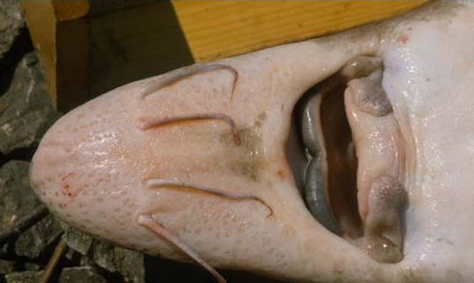
Underside of Lake Sturgeon Head
Photo: John Lyons
Notes:
This photo is taken from the ventral (bottom) side of the sturgeon. What is the general shape of the head (e.g., triangular, rectangular, round, or something else)? What is the general shape of the mouth, and where is it positioned on the head? Do you see any teeth? If so, where are they positioned and how many are there?
What other features are talked about in the book? Can you spot the four whisker-like barbels that help the fish sense food? If you can find them, make note of the barbels’ positions, length, and shape on your “My Sturgeon” handout.

Slide 11
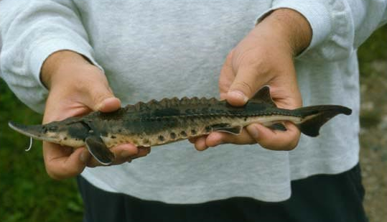
Juvenile Lake Sturgeon
Photo: John Lyons
Notes:
Check out this photograph of a yearling. Do you notice anything different about the sturgeon’s snout?

Slide 12
3D Model of a Lake Sturgeon
3D model of lake sturgeon
Notes:
In this short video, an image of the lake sturgeon was created using a technology called “Sketch Fab” – a technology that renders 3D models.

Slide 13
Drawing Challenge
Sketch a sturgeon using shapes
Sketch a sturgeon in one continuous line without lifting your pencil
Sketch a sturgeon with your eyes closed
Sketch a sturgeon with a piece of paper over your hand
Lake sturgeon
Acipenser fulvescens
Shovelnose sturgeon
Scaphirhynchus platorynchus
Credit: WI DNR
Notes:
Now that we’ve gone over what makes a sturgeon special, it’s time to draw. Decide on the perspective(s) you will use (for example, lateral view (side view), ventral view (from the bottom), dorsal view (from the top)). Pick one way to start your sketch from the sketch design challenge list below. Make sure to use your notes for guidance on what to include (protrusible mouth, barbels, caudal fin, scutes, shape, color, etc.). Choose a sketch design challenge from the list on your handout.
Sketch Design Challenge List
Sketch a sturgeon using shapes
Sketch a sturgeon in one continuous line without lifting your pencil
Sketch a sturgeon with your eyes closed
Sketch a sturgeon with a piece of paper over your hand
Once you’ve sketched the basic outline, feel free to add more details and colors. Sturgeon typically have gray, black, olive, or brown bodies with white or yellow undersides, but feel free to add a personal touch.

