Slide 1
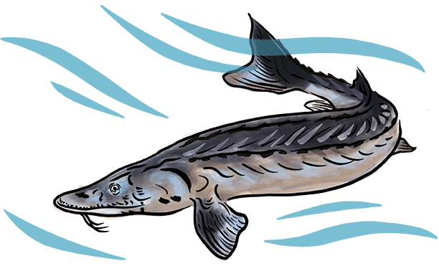
What Is Stewardship?
Stewardship is:
Raising Community Awareness: increasing a community's knowledge of an issue. In most cases the goal of raising community awareness is inspiring others to take action to address that issue.
Participating in Stewardship Science: collecting and reporting monitoring data in an ecosystem that can be used to inform management of the natural resource.
Taking Civic Action: doing something that can improve environmental outcomes for many people or organizations at once.

