Slide 1
Decoy Images

Slide 2
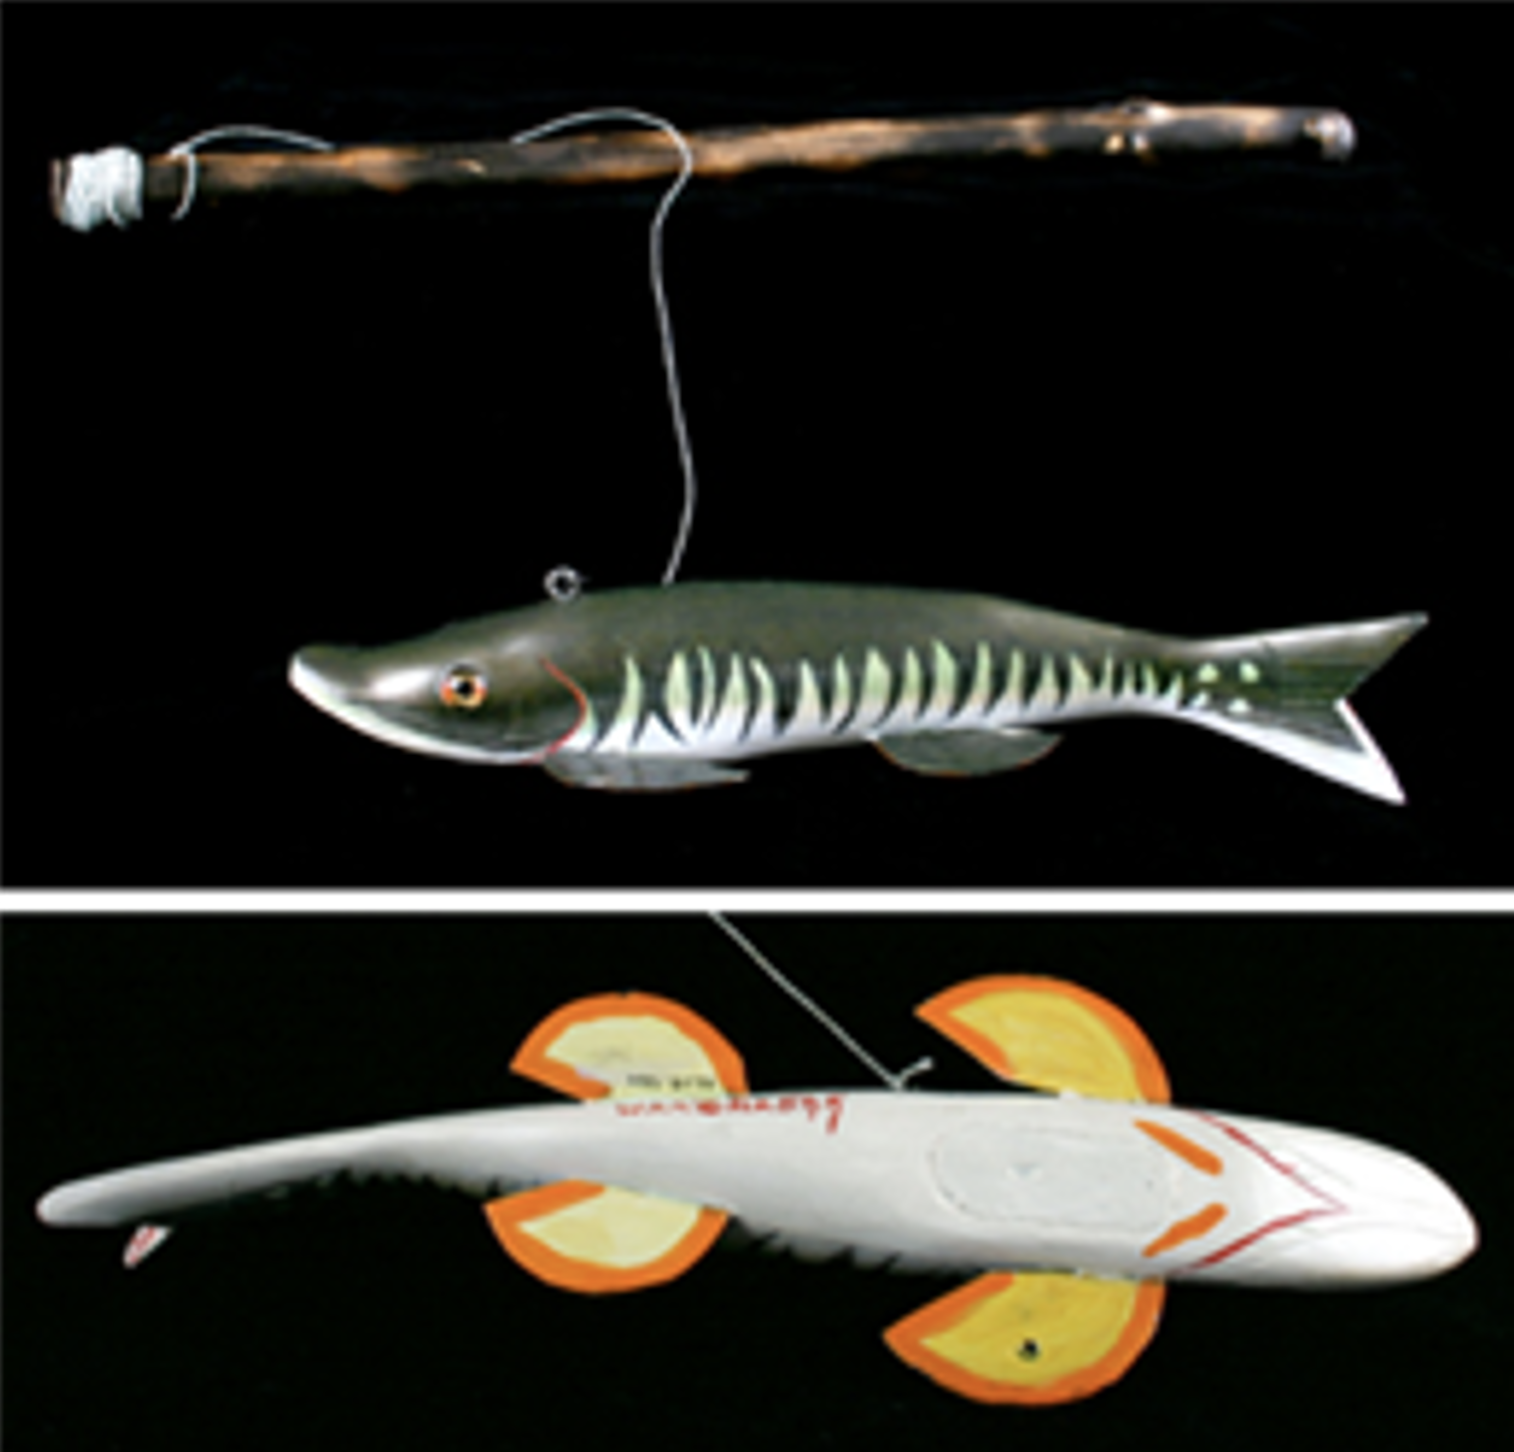
Spearfishing decoy by John Snow
Credit: Wisconsin Historical Museum Object #1996.118.106A-B

Slide 3
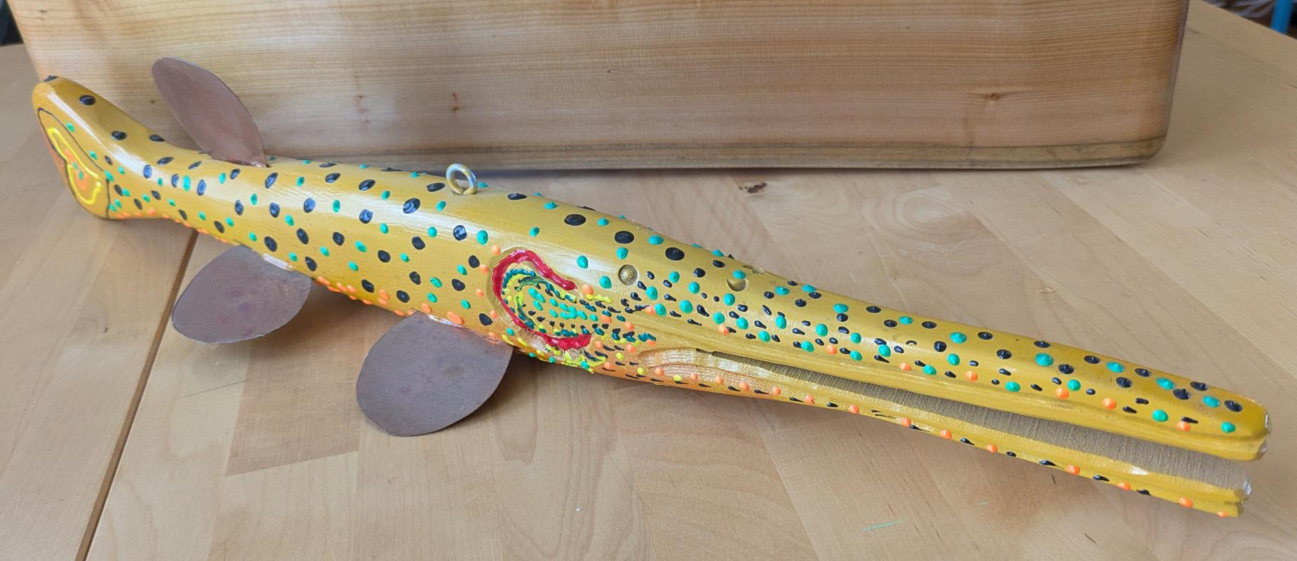
Longnose Gar decoy by Don Ecker

Slide 4
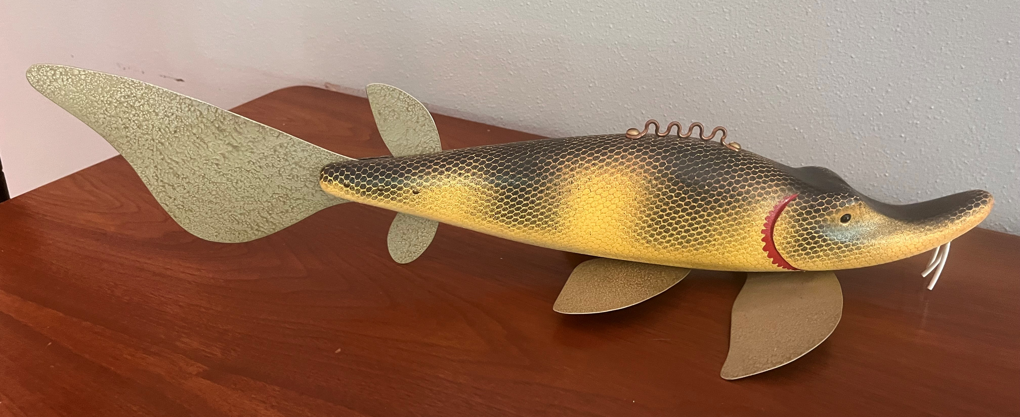
Lake sturgeon decoy by George Schmidt

Slide 5
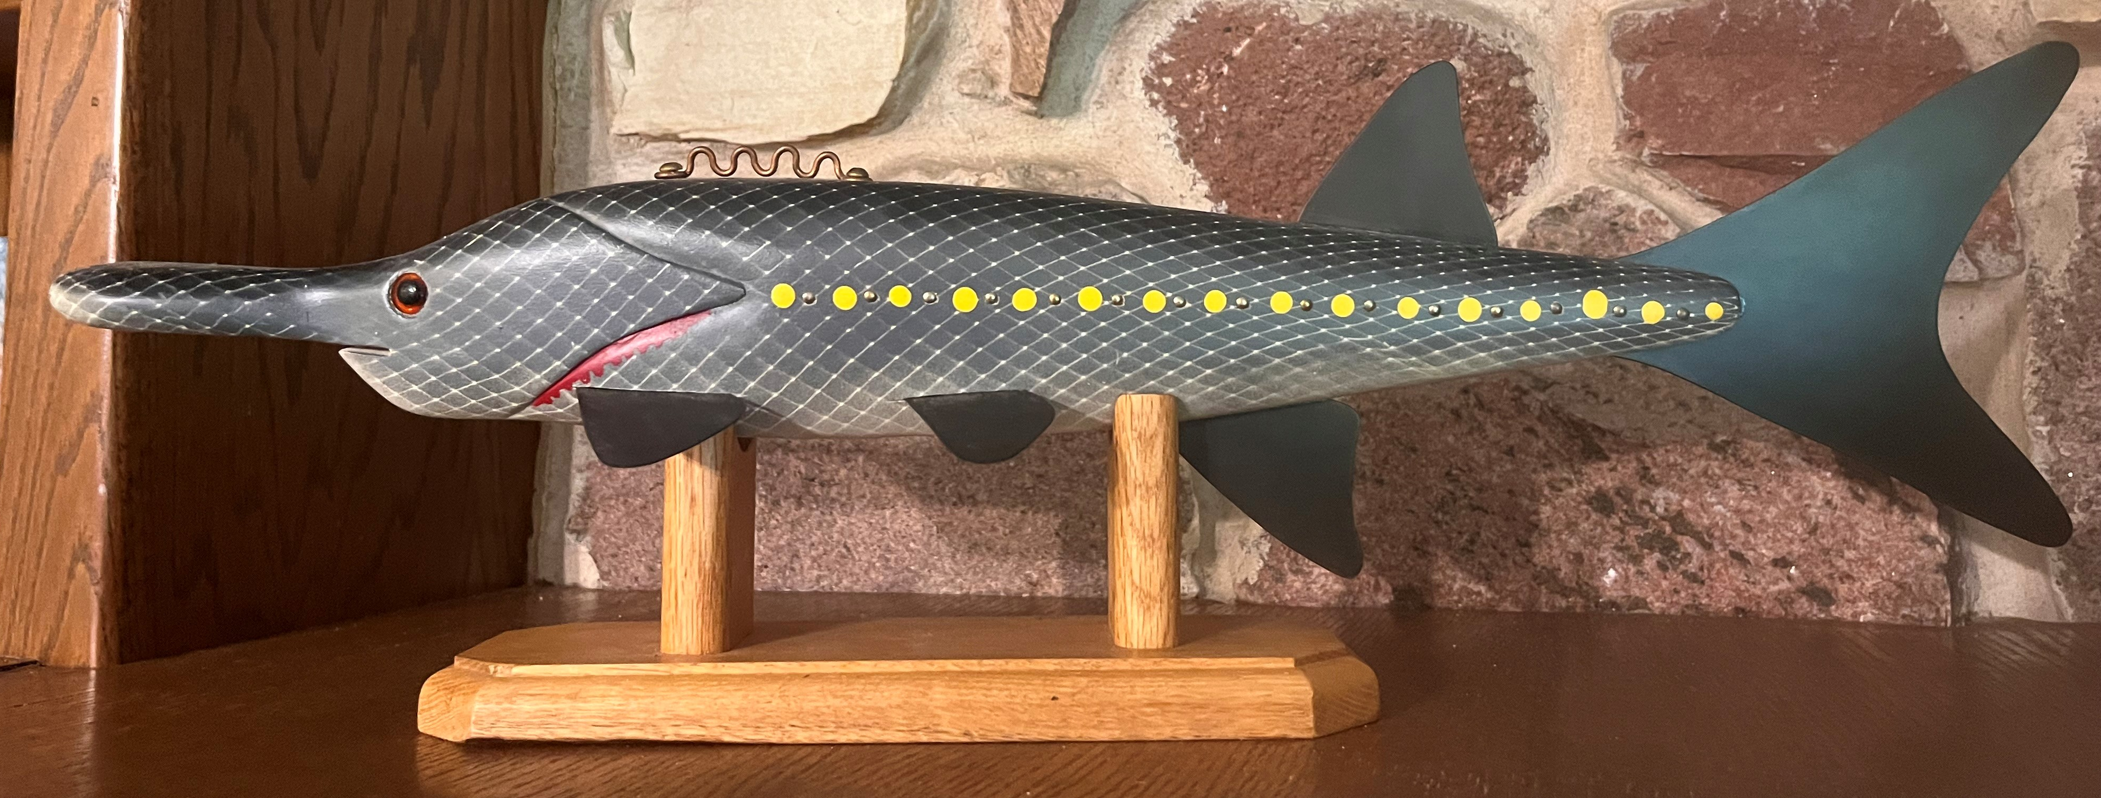
Shovelnose sturgeon decoy by George Schmidt

