Slide 1
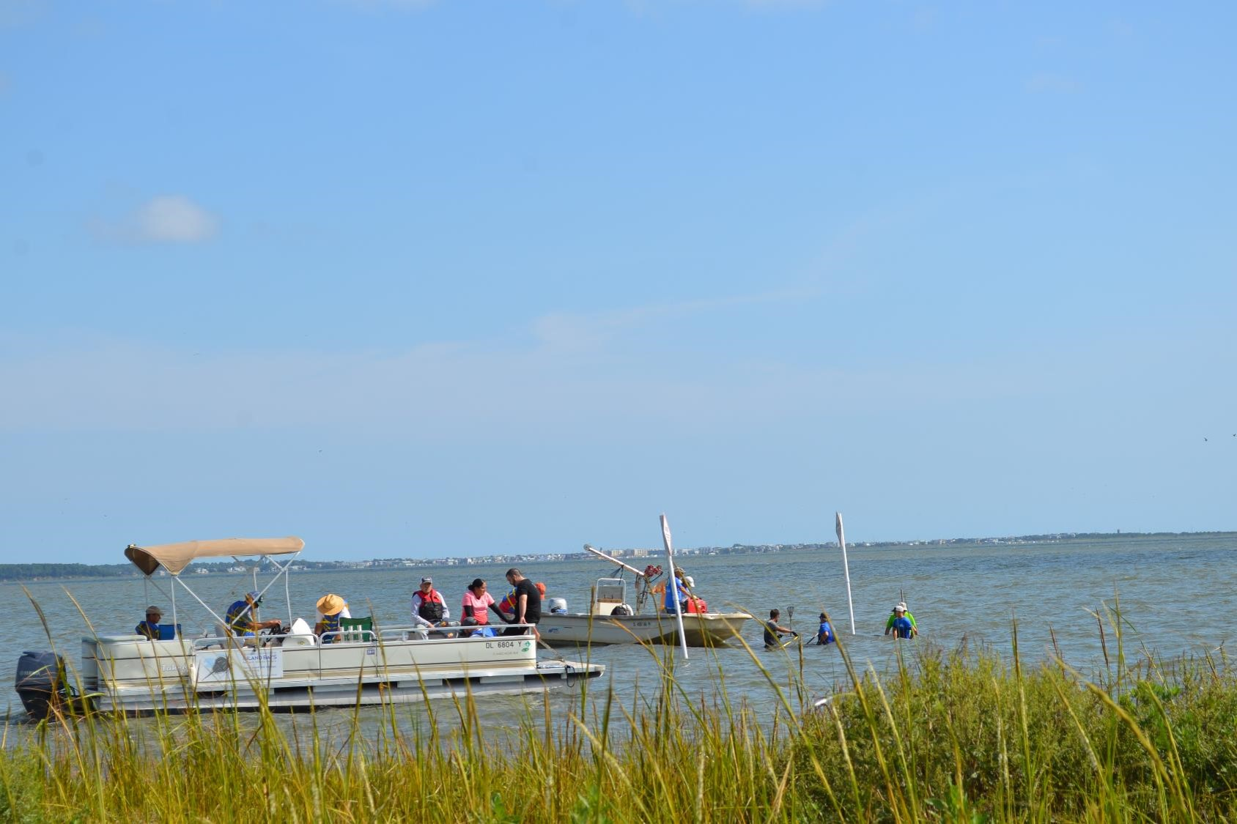
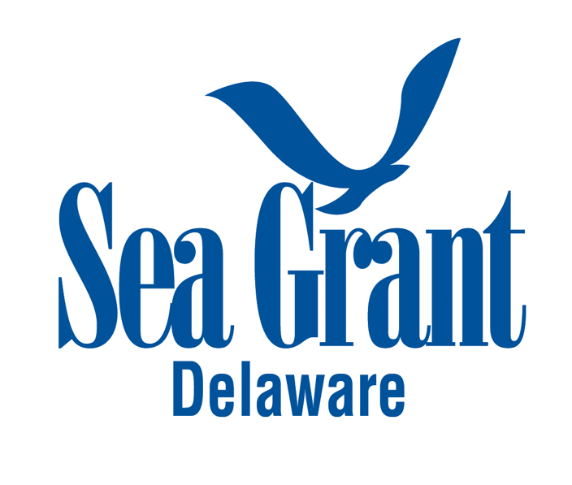
Reporting on Metrics Associated with HCE and SFA
An overview of our approach, challenges & opportunities
Science serving the Delaware coast!

Slide 2
Agenda
Delaware Sea Grant programmatic work
Types of information that are collected
How information is collected
Challenges and opportunities

Slide 3
Programmatic Work
Three tiers of work:
Work that we do ourselves (e.g., projects our Marine Advisory Service staff initiate and lead)
Initiatives that we very strongly support, by providing core funding to partners, with whom we subsequently work to deliver a program or project
Projects that we support by providing funding to external partners with less direct engagement (e.g., community initiatives and seed projects supported through Program Development Funds)

Slide 4
Types of Information
Programmatic work reflected in Delaware Sea Grant Strategic Plan
National Sea Grant Office metrics
Number of peer-reviewed publications produced by Sea Grant
Delaware-specific metrics
Number of students at two-year institutions that will be engaged in workforce development programs focused on teaching applicable, real-world skills that meet the emerging needs of our coastal state
Certain metrics correspond better to certain partners

Slide 5
Approach
eSeaGrant
Separate report call for partners and internal work
Exported from eSeaGrant and input into PIER
Partners
Fairly narrow scope
Up-front meetings to discuss metrics and reporting process
Simply ask researchers through eSeaGrant annually
Internal
Annual work plans
Quarterly reports submitted through Qualtrics
Compiled annually, submitted into eSeaGrant

Slide 6
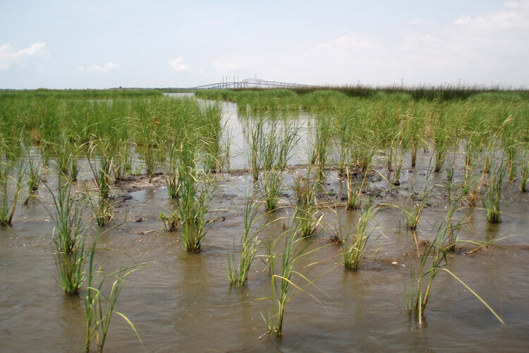
Healthy Coastal Ecosystems
Number of resource managers who use ecosystem-based approaches in the management of land, water, and living resources as a result of Sea Grant activities
Number of acres of coastal habitat protected, enhanced, or restored as a result of Sea Grant activities

Slide 7
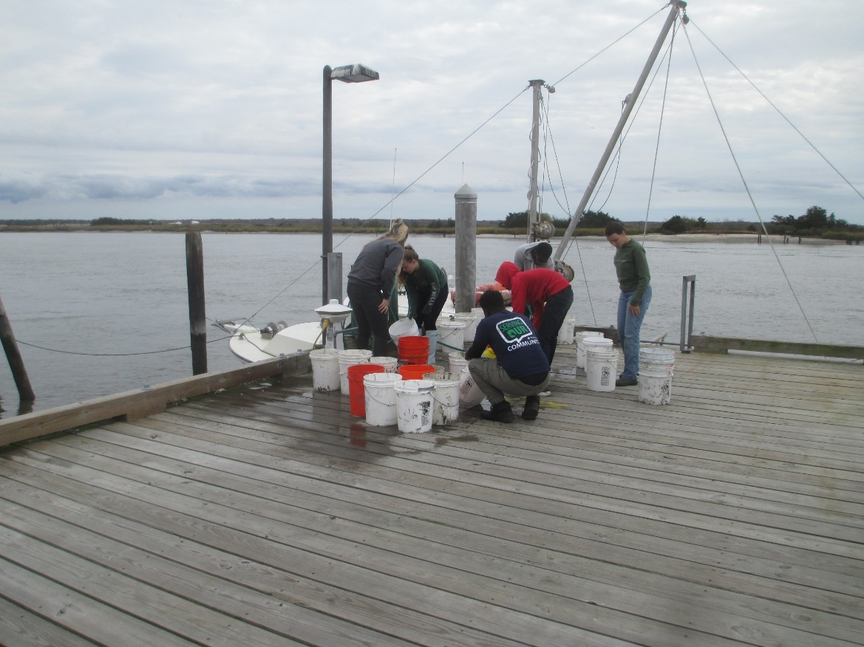
Sustainable Fisheries and Aquaculture
Number of fishermen, seafood processing or aquaculture industry personnel who modify their practices using knowledge gained in fisheries sustainability and seafood safety as a result of Sea Grant activities

Slide 8
Challenges & Opportunities
Engagement with reporting process / level of effort
Both external & internal
e.g., number of fishermen, seafood processing or aquaculture industry personnel who modify their practices…
Takes a bit to think about this & track
Some confusion around the metrics that requires interpretation
e.g., acres of habitat restored through something like aquaculture
Is it acres where oysters have been placed? Volume of water filtered?
Reasonable and justifiable

Slide 9
Challenges & Opportunities (Cont.)
Double counting not an issue across projects, but across years
Associated with the National Sea Grant metrics
e.g., number of resource managers who use ecosystem-based approaches in the management of land, water, and living resources as a result of Sea Grant activities
There are only so many managers, what happens through continued engagement?
eSeaGrant
Average user
Challenge for internal work because it all falls under a single project code: A/I

Slide 10
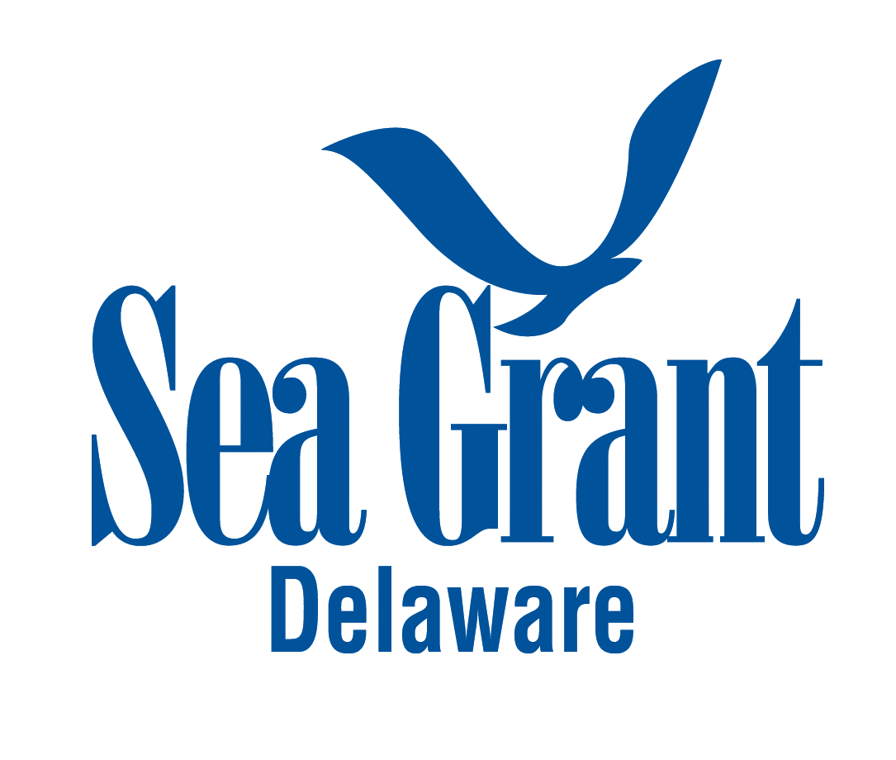
Take Home Message
Communication & education key
Challenges with the metrics themselves
Pros and cons to eSeaGrant
Science serving the Delaware coast!
For more information, contact:
Christian Hauser
Associate Director, Delaware Sea Grant
hauser@udel.edu
www.deseagrant.org
Questions…
And Thank You!

