Slide 2
Melissa Boyce
Financial Manager
Wisconsin Sea Grant
How Wisconsin Sea Grant Manages
Estimated Level of Effort per Focus Area
Sea Grant Collaborative Reporting Meeting February 2, 2022
Virtual - Madison, Wisconsin
February 1-3, 2022

Slide 3
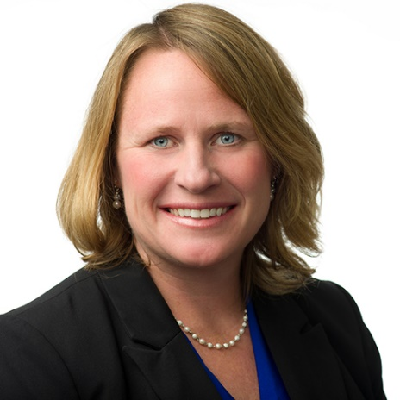
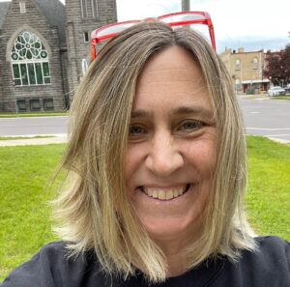
Wisconsin Sea Grant Program Staff Involved
Jim Hurley, Wisconsin Sea Grant
Director
Jen Hauxwell, Wisconsin Sea Grant
Associate Director (Research Coordinator)
Melissa Boyce, Wisconsin Sea Grant
Fiscal Officer

Slide 4
Estimated Level of Effort per Focus Area
Where it begins
1. Original designation – PI Submitting a Proposal Chooses
2. Associate Director reviews to make sure PI Option is appropriate based on abstract and comparison to our strategic plan elements
3. Some projects are submitted through a Special Topic in the RFP, for example JEDI (Justice, Equity, Diversity, Inclusion). This is to draw attention in the RFP. Since JEDI isn’t one of our overall focus areas, each of these will receive a review from our Associate Director who then will assign the primary focus area
4. Our primary focus areas are evident/shown through our naming
– for example R/SFA-26
5. The primary focus areas are then entered into the 90-2

Slide 5
Inside Sea Grant
Inside Sea Grant Guidance
The level of effort summary table at the top of the “estimated level of effort per focus area” section of PIER is calculated from the level of effort information on all of the program’s individual projects (the second table of the page) and any managed leveraged funds the program reported (third table). It is the responsibility of the programs to make changes in PIER. There are two ways a program may change the overall estimated level of effort:
1. Change the values in the individual project table (PIER project section) and the managed leveraged funds tables (PIER leveraged funding section), or 2. Change level of effort on the PIER “estimated level of effort per focus area” section. If the projects or managed-leveraged funds are associated with more than one national focus area, click edit, adjust the percentages for each national focus area, and click save.
Changes should be reflected in the top summary table.
Note: For bulk extension, program development (PD), and management projects that contain multiple focus areas, PIER will assign 100% to the primary focus area. A program will need to go into PIER and assign level of effort to each focus area in those projects.

Slide 6
Summary of steps
Verify all leveraged funding has been entered
Go into PIER and download into excel
Format excel document so that it’s easily able to be reviewed and enter formulas so that dollar amounts show
Get updates from the WISG Director
Go into PIER and update as needed

Slide 7
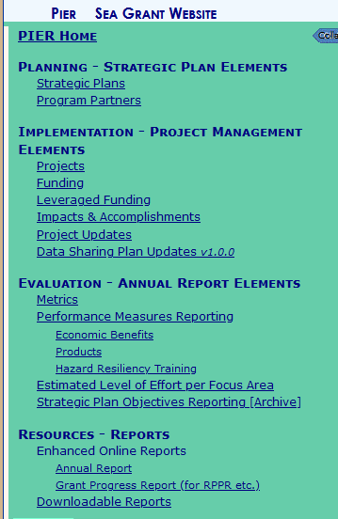
Sign into PIER and click on
- Estimated Level of Effort per Focus Area
- Choose the Annual Report Year that you are working on

Slide 8
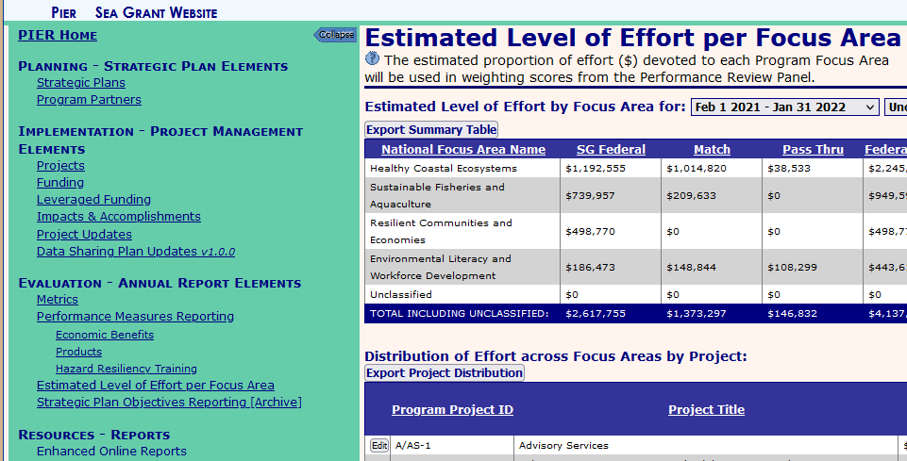
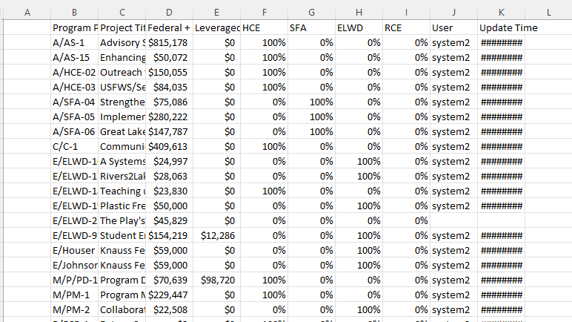
Export Project Distribution
Initial view in Excel looks similar to this

Slide 9
Prior to sending/sharing the excel document with the Director, formatting and formulas are added so that it’s an easily interpreted excel document. I pull the previous year excel document and use the format painter to make it simple. Please note that the original export contains % only while the above shows both the % and dollar value
PIER automatically includes the % of effort, along with the overall funding in each area (based on submitted 90-2 information and entries made for Leveraged Funding) – this includes Federal, Match and Pass Through, along with Managed-Leveraged Funding. So prior to finalizing the Level of Effort you need to have completed entry of all of your Leveraged Funding

Slide 10
Director reviews and updates
- Depending on what works best each year, sometimes the Director and I meet and discuss updates in person and other times he enters the changes and highlights them as shown above and emails the excel document back to me.

Slide 11
Once I have what needs to be updated, I go back into PIER and update directly on the Distribution of Effort across Focus Areas by Project “page/area”

