Slide 1
Collaborative Reporting Meeting: Metrics
Kristen DeVanna Fussell, PhD, Associate Director, Ohio Sea Grant
Erin Monaco, Program Administrator, Ohio Sea Grant

Slide 2
Metrics reporting - Organization is key
Excel spreadsheet of all metrics on one tab
Each metric has a cell full of notes
Where do I get numbers from?
Helpful tips or things to remember
Previous few years of data included
Also take notes for future years
Annual Action Plan meeting in January
Touchpoint with staff – Are we meeting targets?
Take notes for the future year (I will not remember unless notes are taken!)
Grants ending
New events
Changes to programming I should be aware of

Slide 3
Metrics reporting - Organization is key
Keep hidden until number for current year is calculated. I use this to check myself.
Organization of Spreadsheet
 | Notes | 2019 | Comment | 2020 | Comment | 2021 | Comment
Sea Grant sponsored events | Where do I get data from?
Attendees @ SGSE | Who do I chat with about this? |  | Notes to myself for each year.
Presentations | Things to remember.

Slide 4
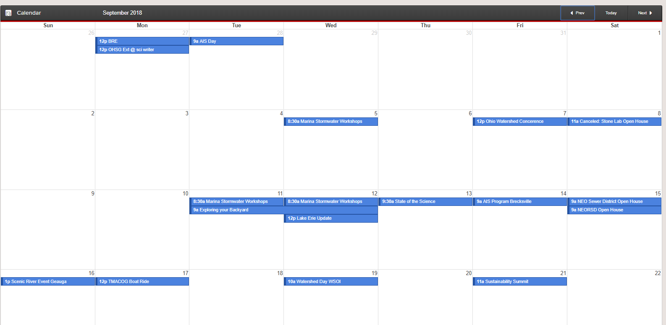
How we collect our metrics
Personal communication with staff
Communications and reporting with PI’s and students
Our internal events database (Mystro)
Notes:
Regular touchpoints through out the process

Slide 5
Sea Grant Staffing

Slide 6
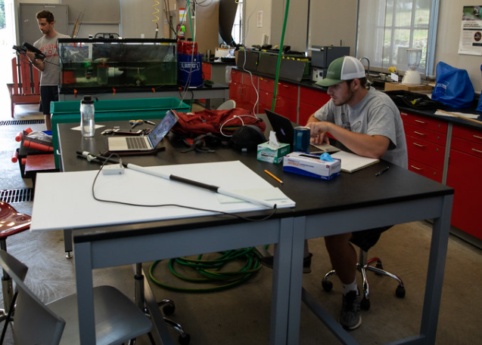
Sea Grant Staffing
Work with Business Manager on all staff hired by OHSG
Full-time, part-time, seasonal, students
Assist with category classifications
Use research annual reports for PI, graduate student and undergraduate numbers
Ask for PI person-months
Number of students supported
Degree student is seeking
Start date of student on project
Amount of student time on project
Did student graduate?
Notes:
Regular PI Portal meetings and review of projects/deadlines; decision making on where paid from; collaboration with program leaders, business manager, and PIs.

Slide 7
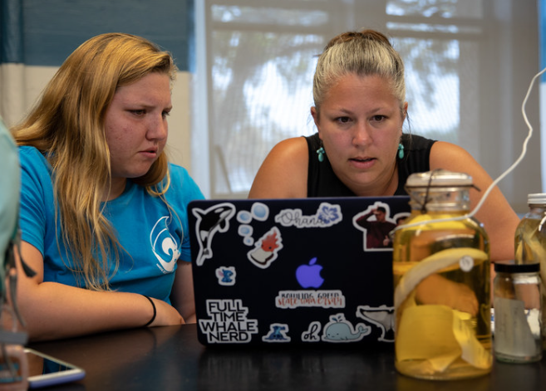
Core funding
Work with your program’s Research Coordinator for this metric
Pre- and Full Proposals submitted and funded
Number submitted and funded from home institution
I include all large and small grant proposals from our core omnibus funding
Notes:
Regular touchpoints through out the process

Slide 8
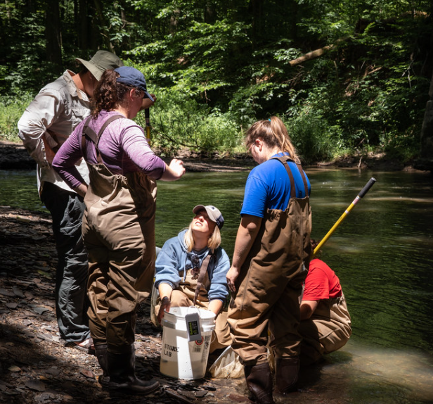
Supported students
Work with Business Manager and OHSG staff students supported by the program (hired as seasonal staff, scholarships, fellows, RA’s)
Use research annual reports for students supported by research funding

Slide 9
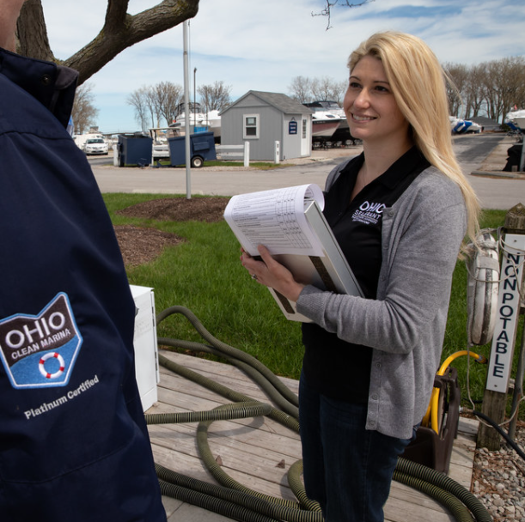
Clean Marina and HACCP
Statewide programming
HACCP: AIS and seafood
Connect with our extension educators conducting the programming

Slide 10
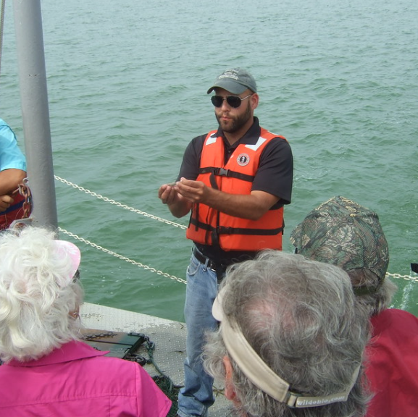
Volunteer hours
Beach clean up volunteers
Friends of Stone Laboratory – island clean-up, events
Charter captain volunteers
Lake Erie Watersnake sampling

Slide 11
OHSG programs and events
Internal database: Mystro people, events, publications and reporting

Slide 12
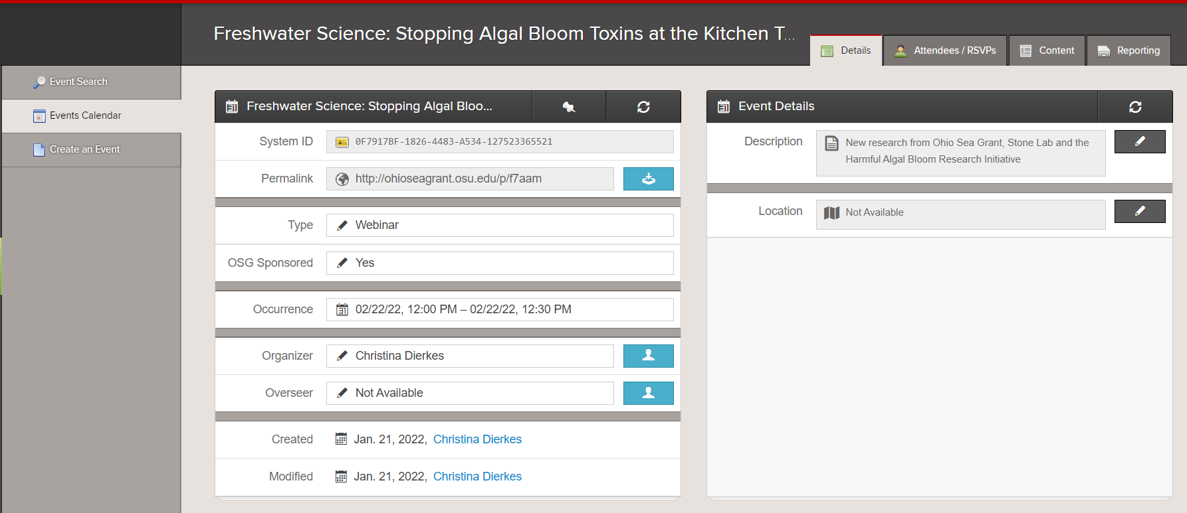
OHSG sponsored events and attendees
Query event database

Slide 13
OHSG sponsored events and attendees
Query event database
Sort by OHSG sponsored events and add attendees
Does take some clean-up on my end
Try to have staff report events as they happen

Slide 14
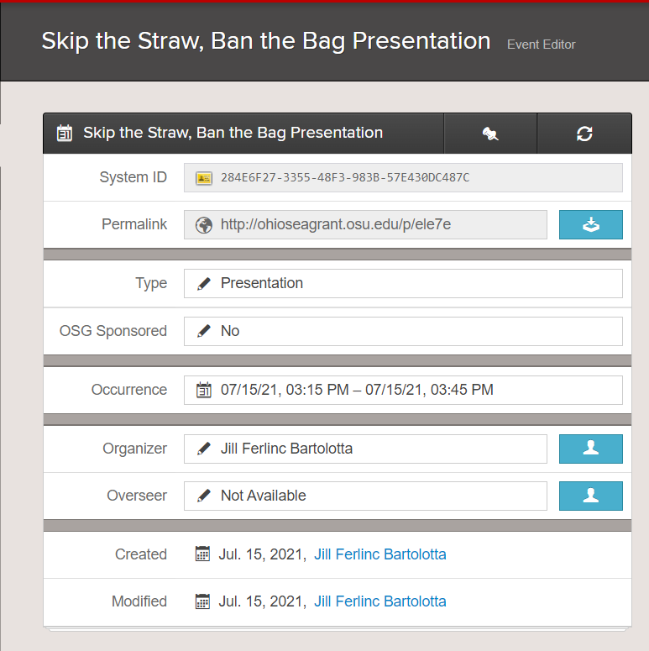
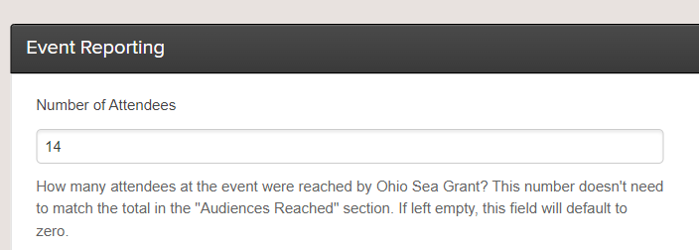
Presentations and attendees
Query event database

Slide 15
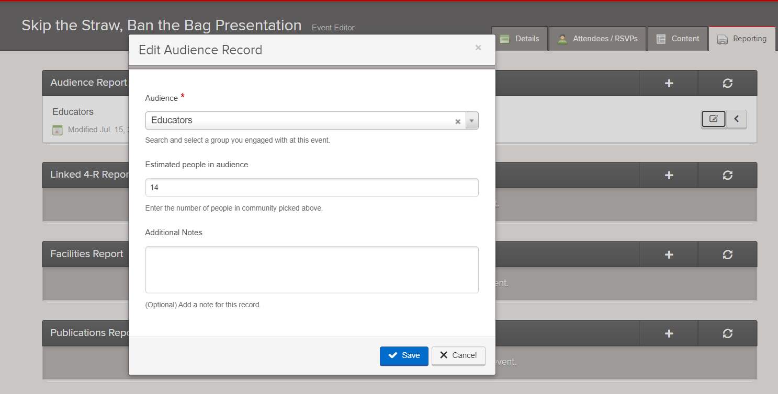
P-12 Educators

Slide 16
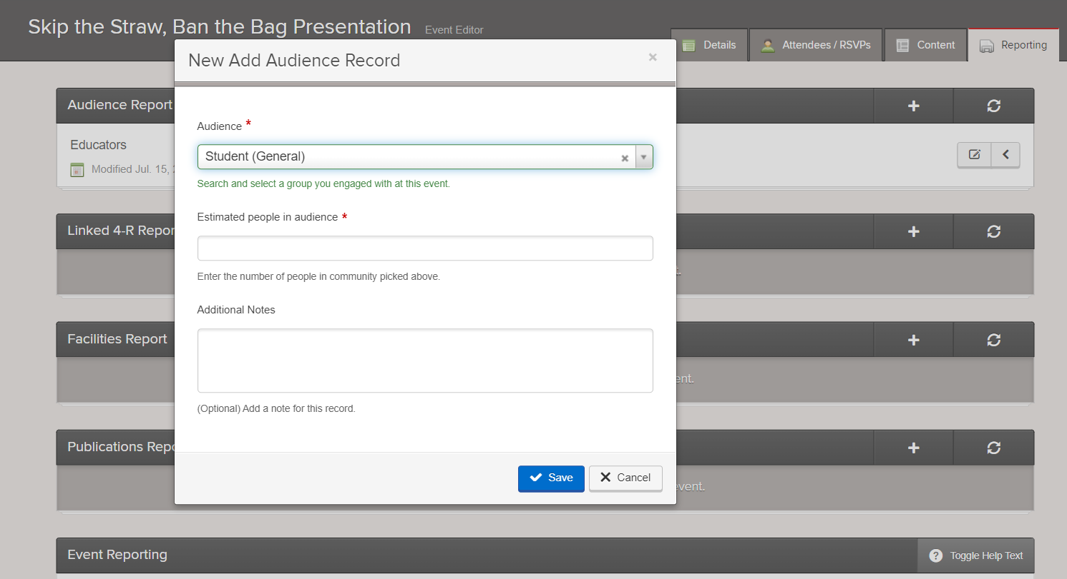
P-12 Students Reached

Slide 17
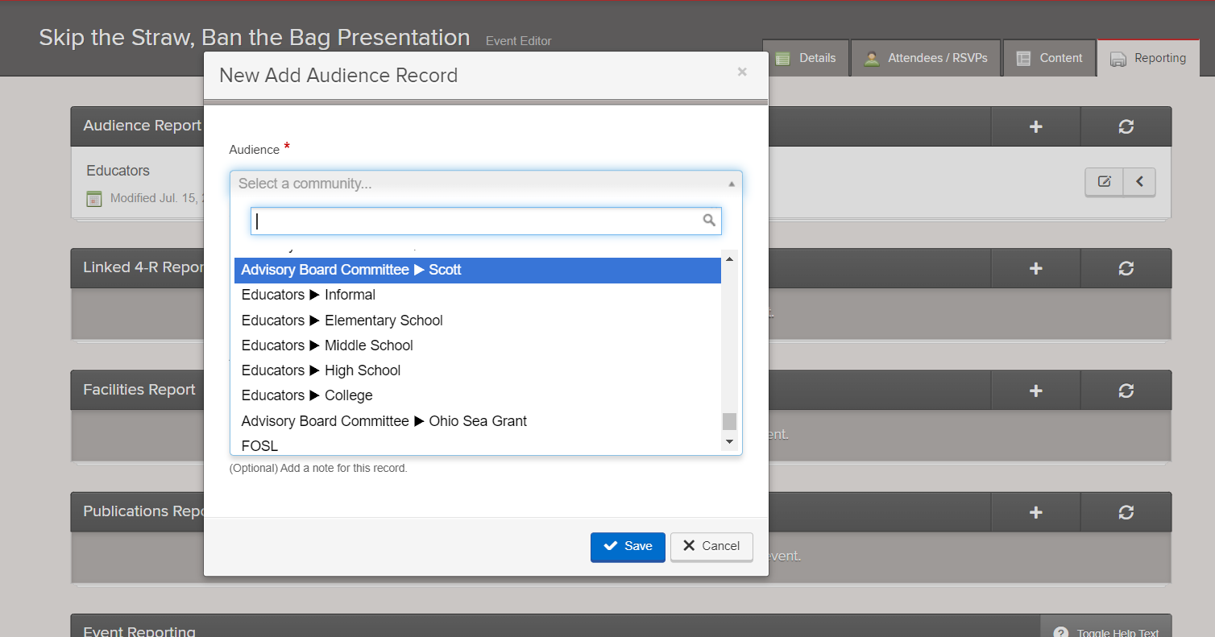
P-12 Students Reached

Slide 18
P-12 Students Reached
We use multipliers for educators in different grade levels to estimate number of students reached from educators impacted
Elementary - x30
Middle School – x100
High School – x120
Informal (or all unknown) – x1

Slide 19
Publications to National Library
We use our database to track these as well
Ask PI’s and staff to send us the pre-publication manuscripts
Ask for publication updates in PI annual reports
Ask PI’s for publication updates at least once a year for five years after the end-date of project
Search google scholar for Ohio Sea Grant in acknowledgments

Slide 20
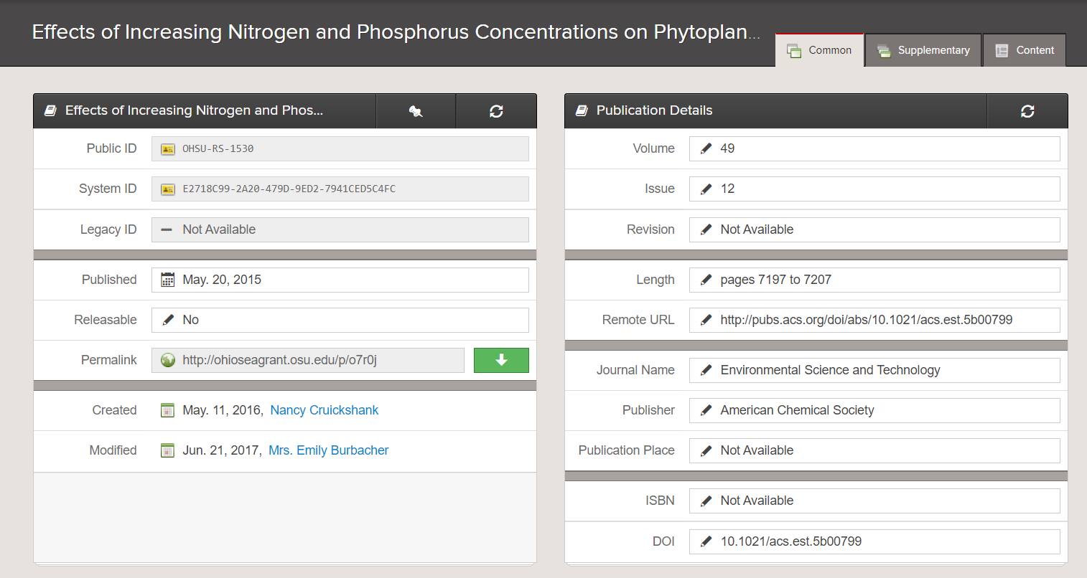
Publications to National Library

Slide 21
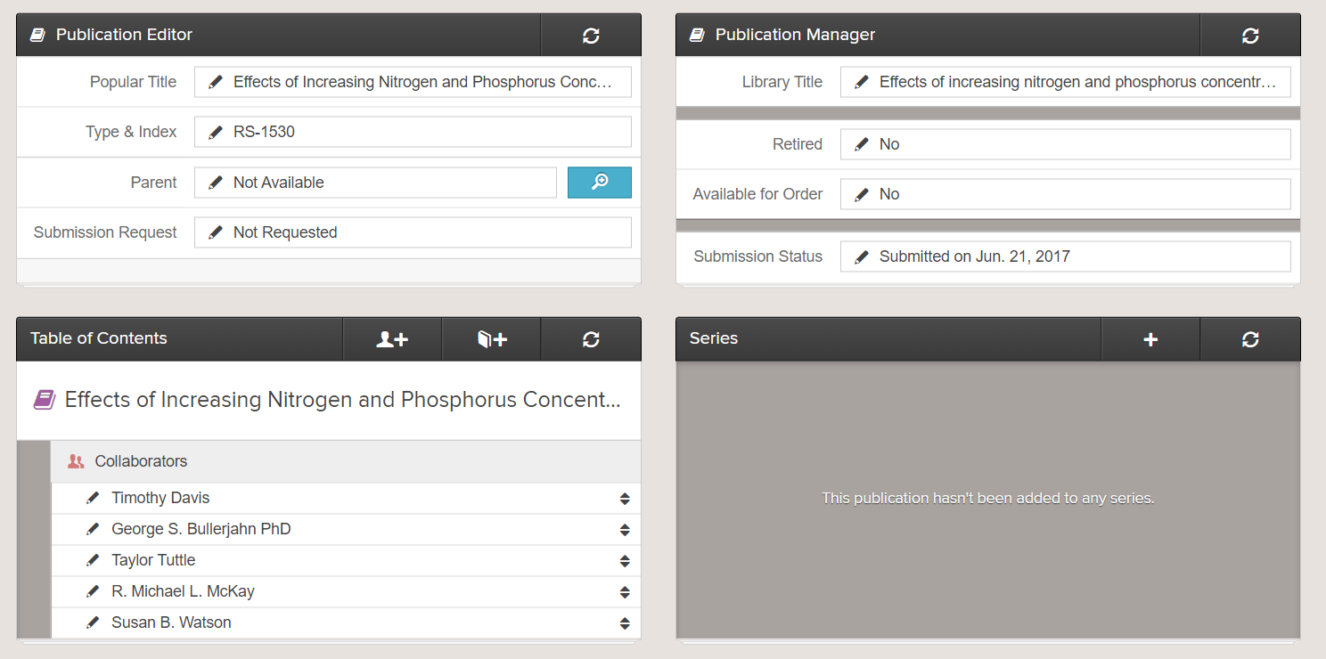
Publications to National Library

Slide 22
Any Questions?
Kristen DeVanna Fussell
fussell.10@osu.edu
614-292-8971

