Slide 1


Resilient Communities and Economies: Measuring our Performance
Collaborative Reporting Meeting
February 2-4, 2022
Beth Bisson, Maine Sea Grant

Slide 2
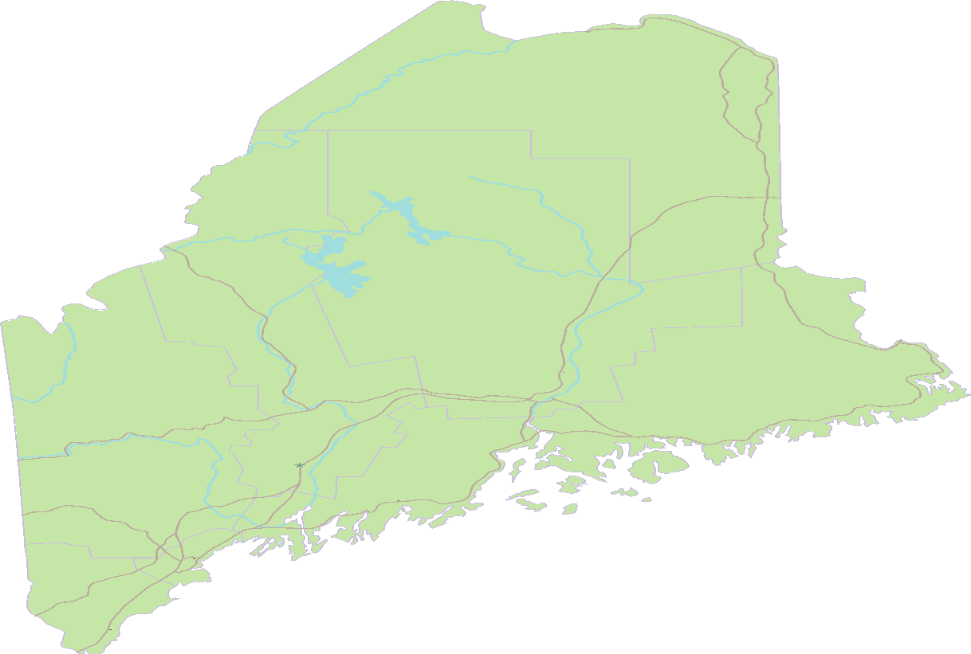
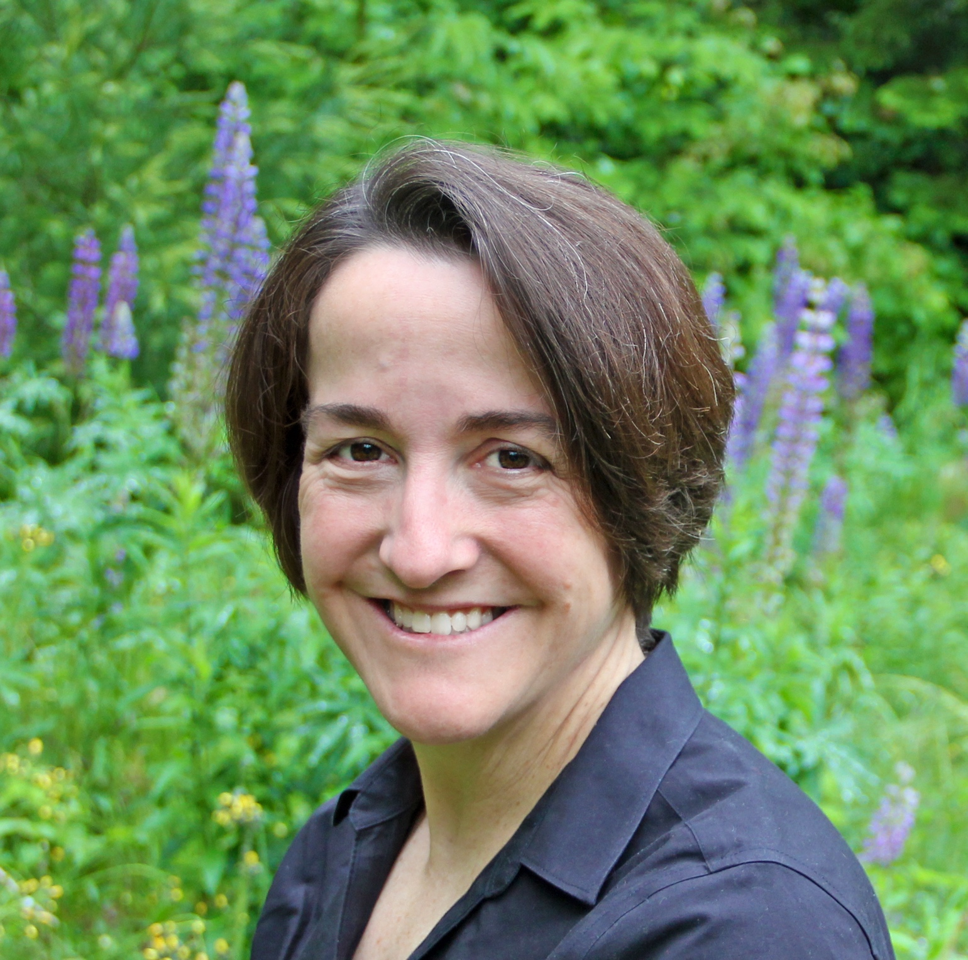
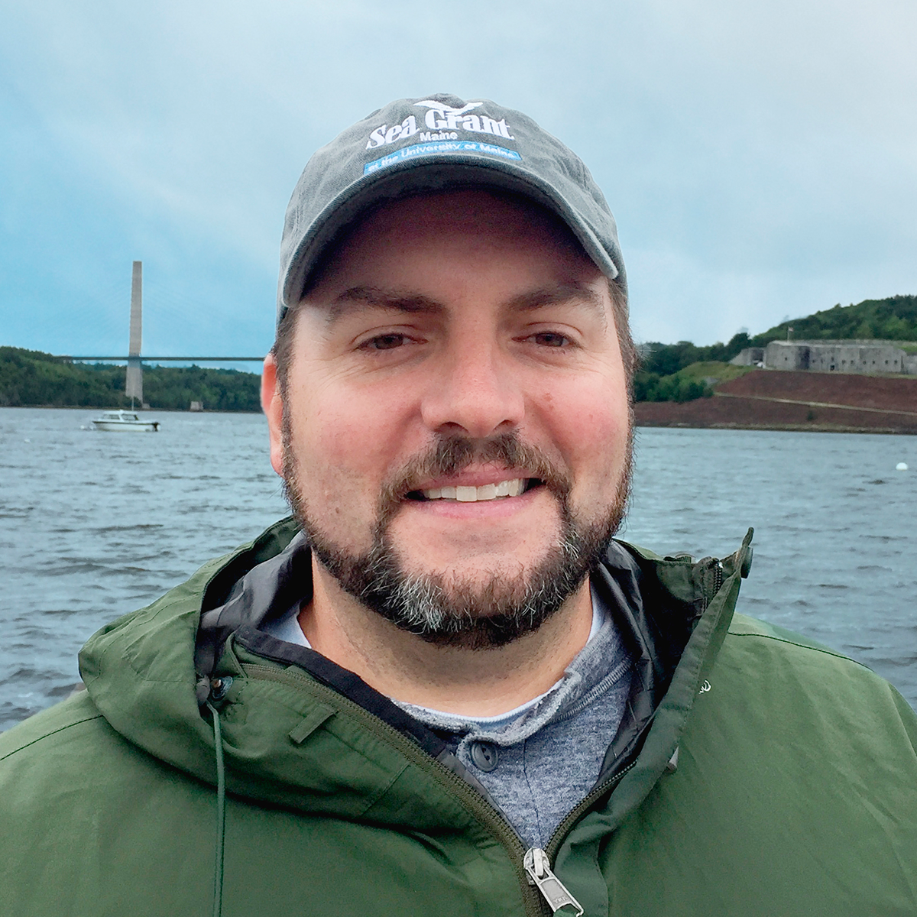
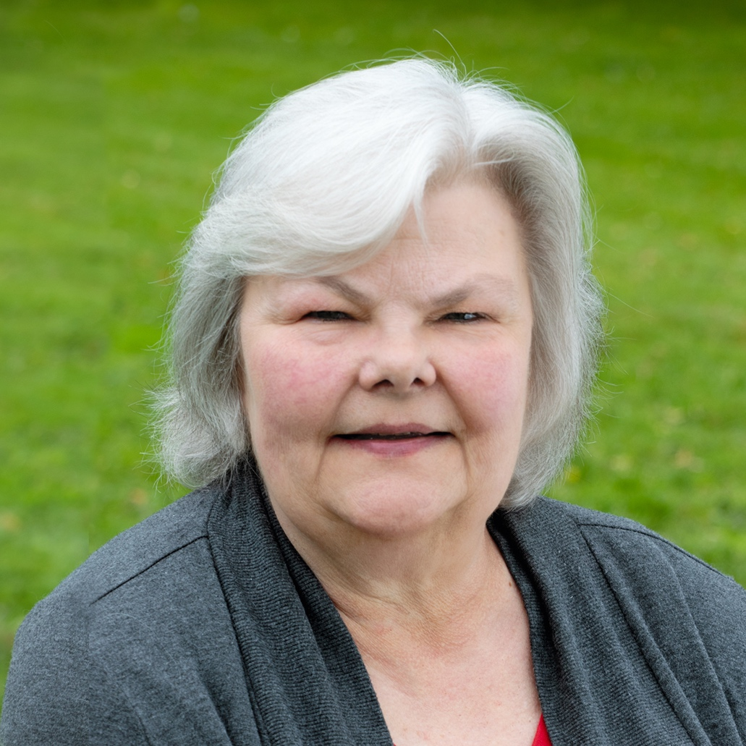

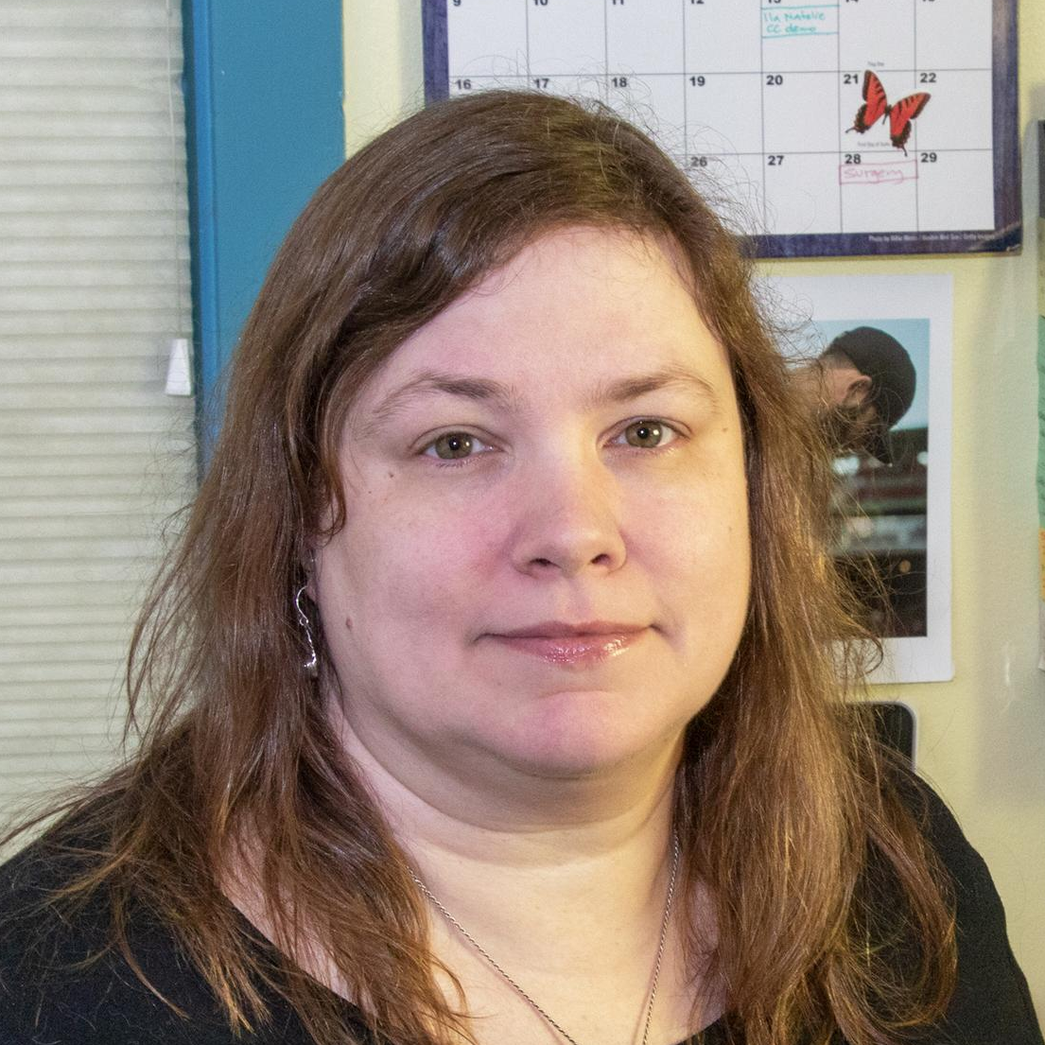
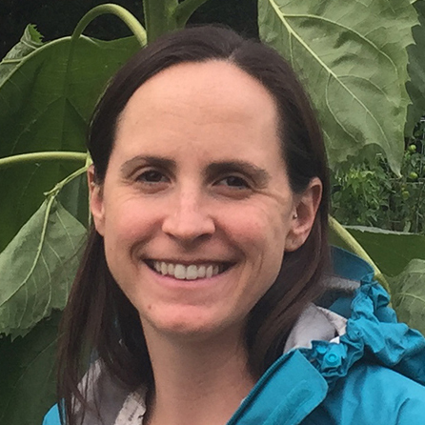
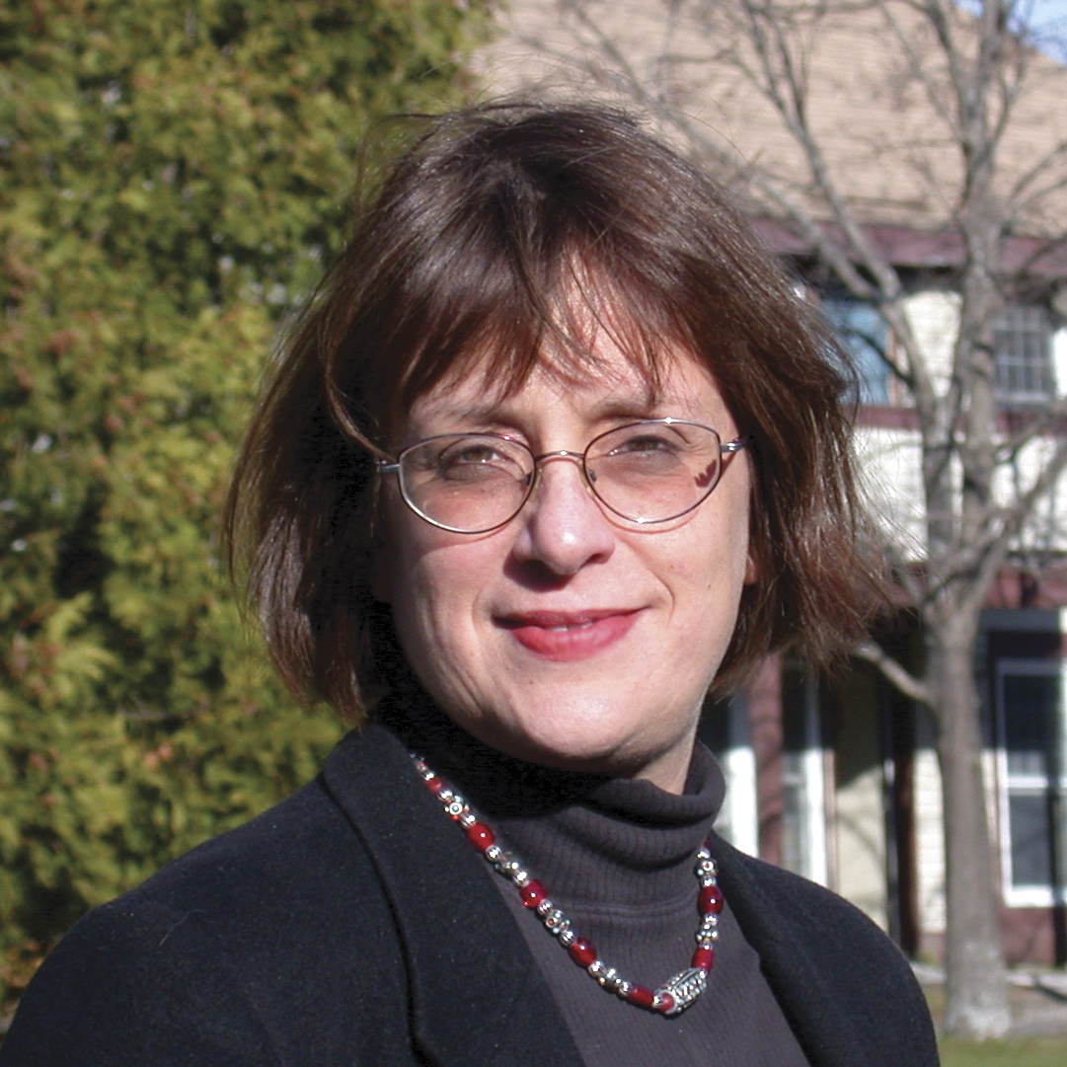
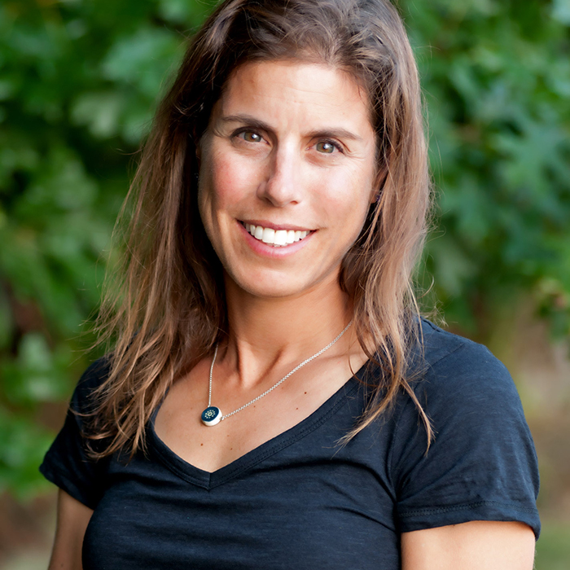
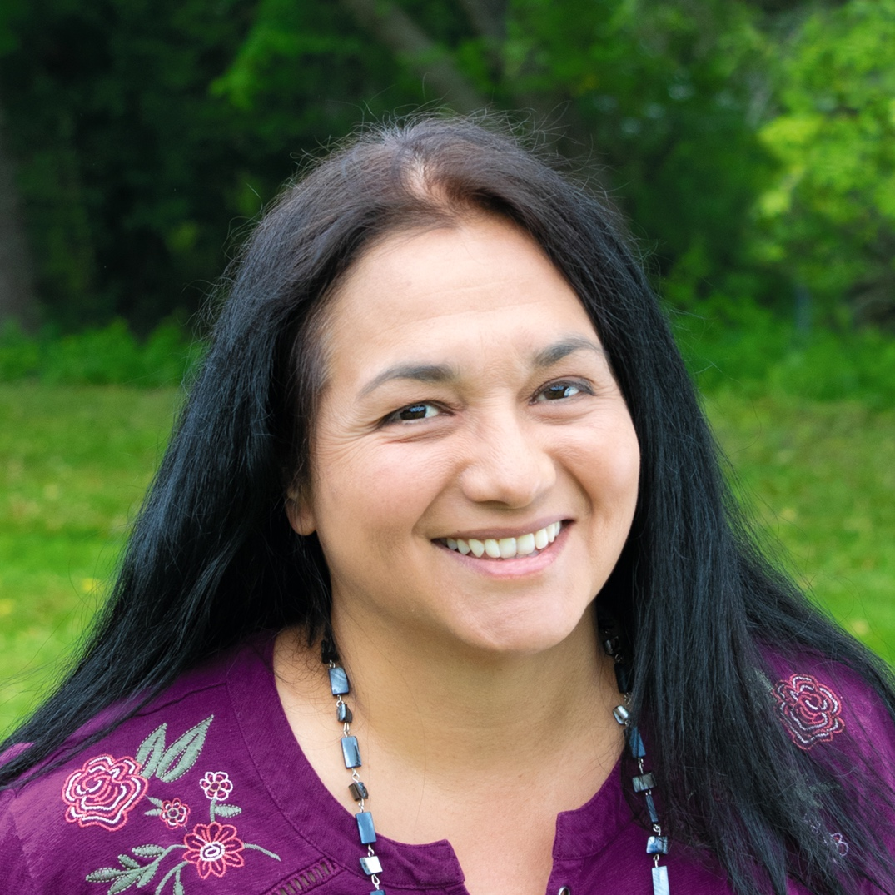
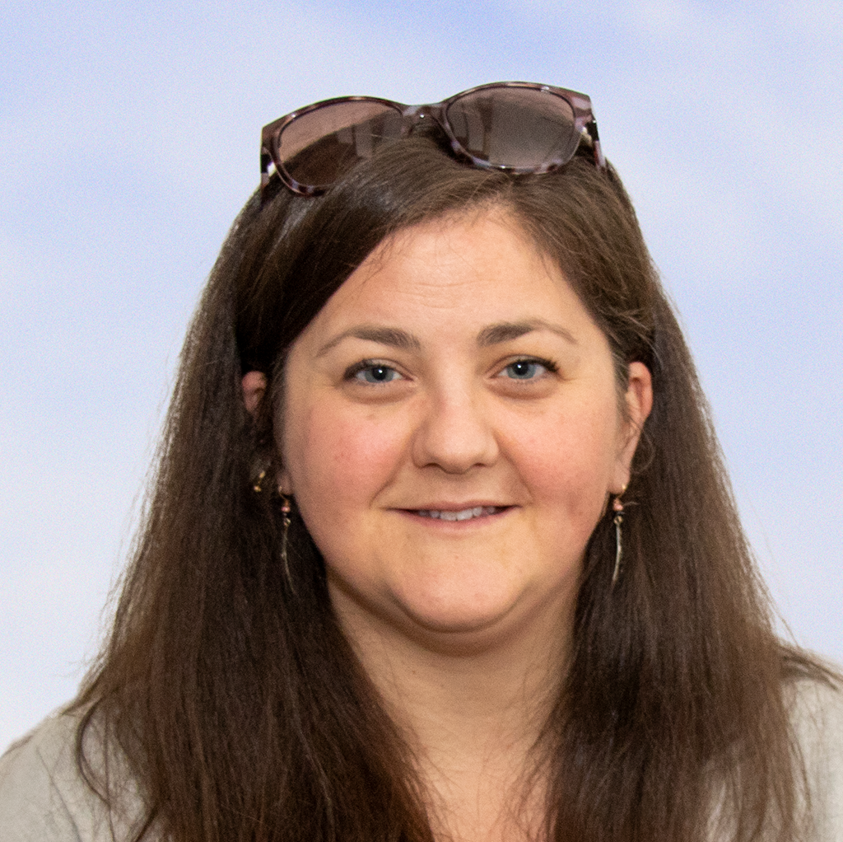
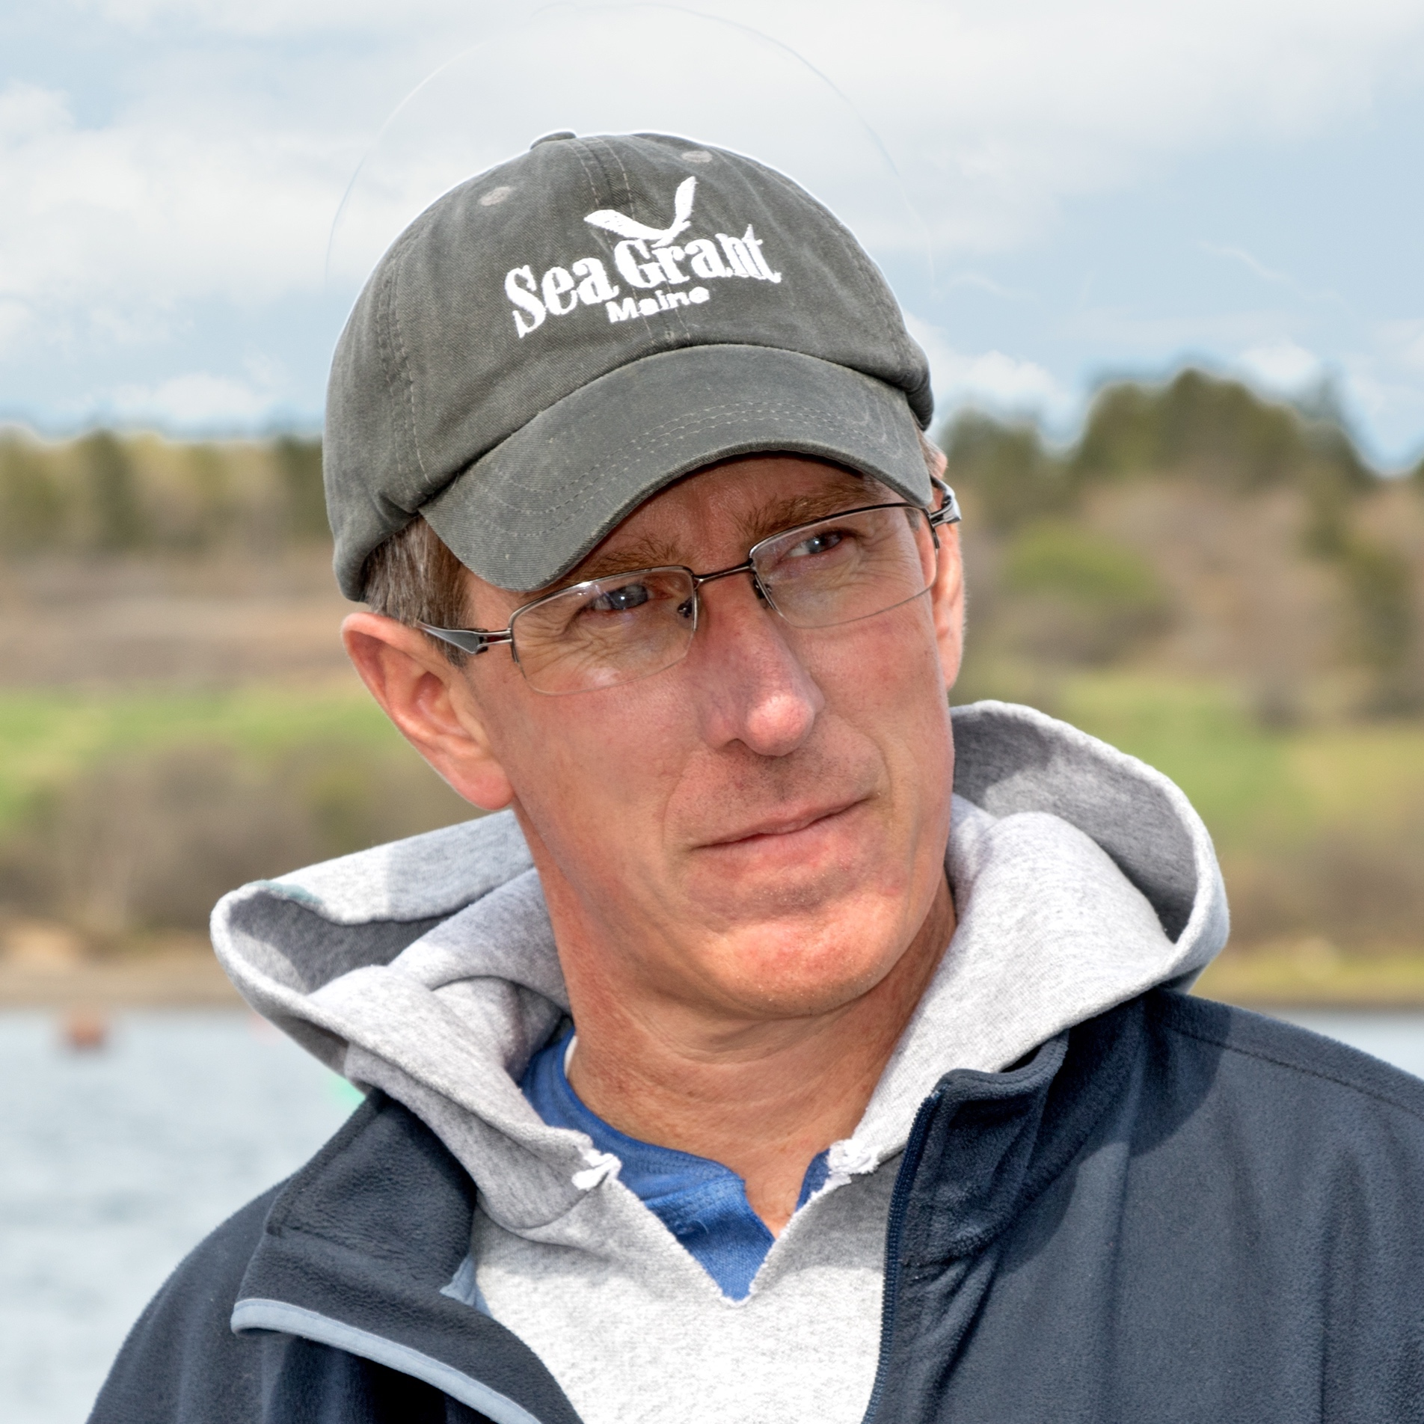
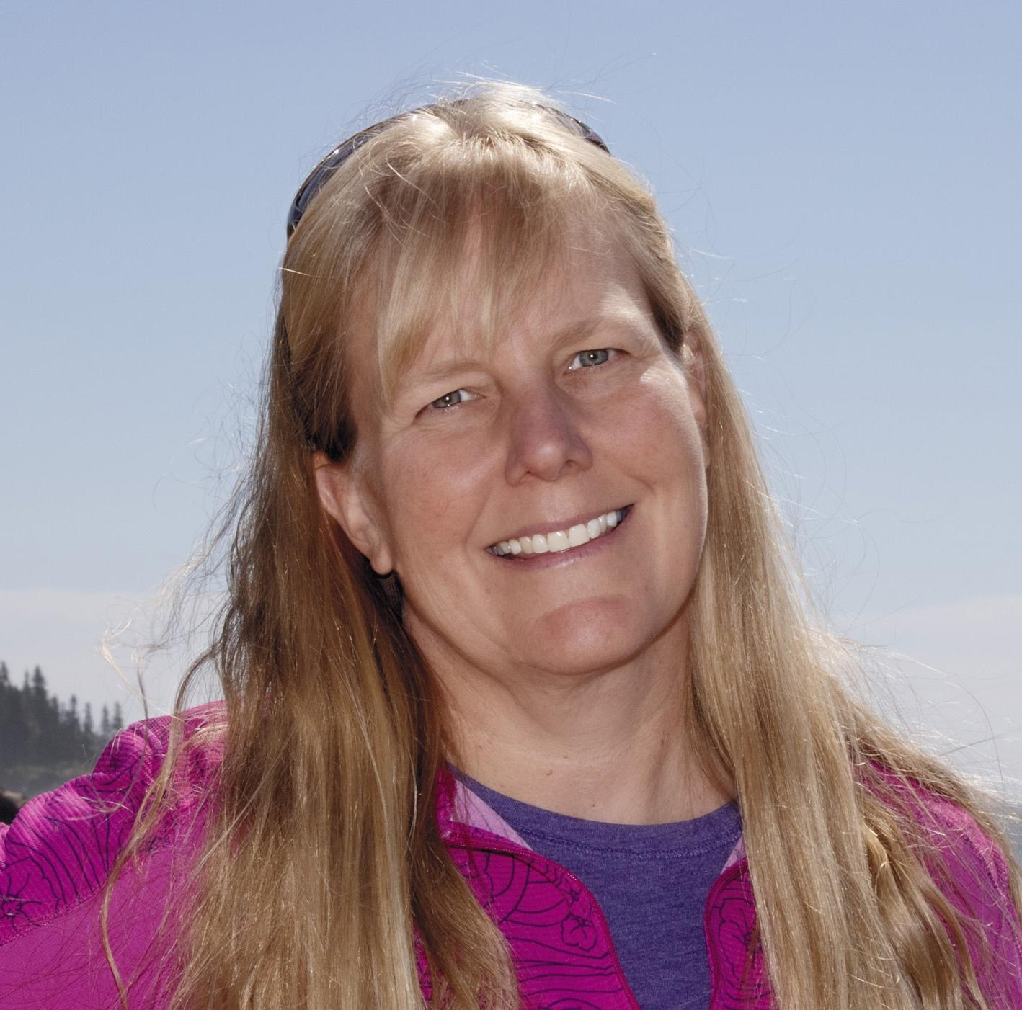
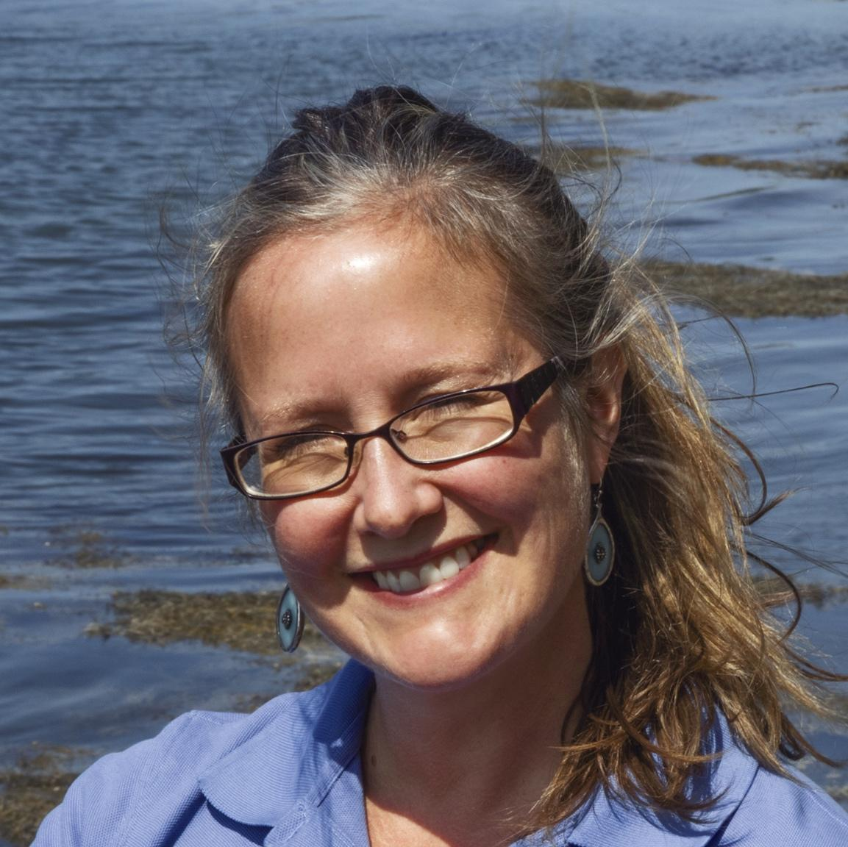
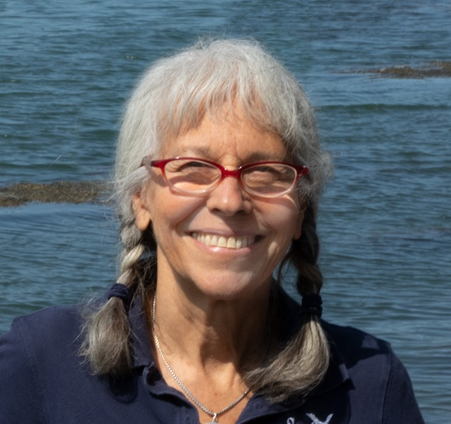
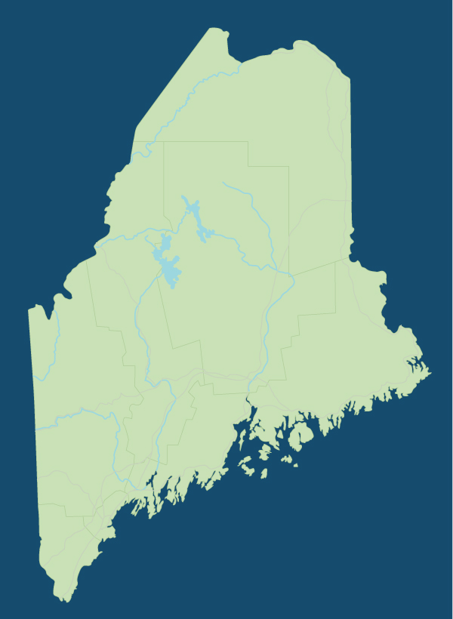
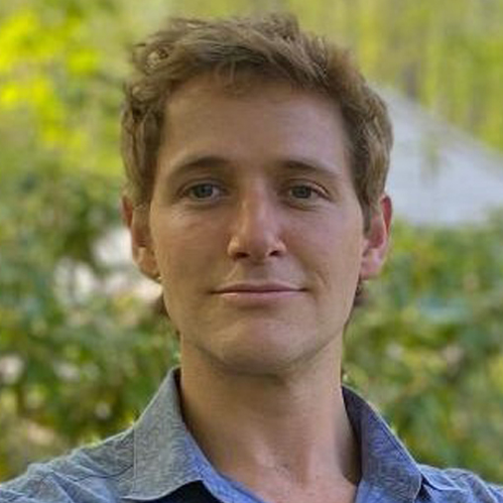
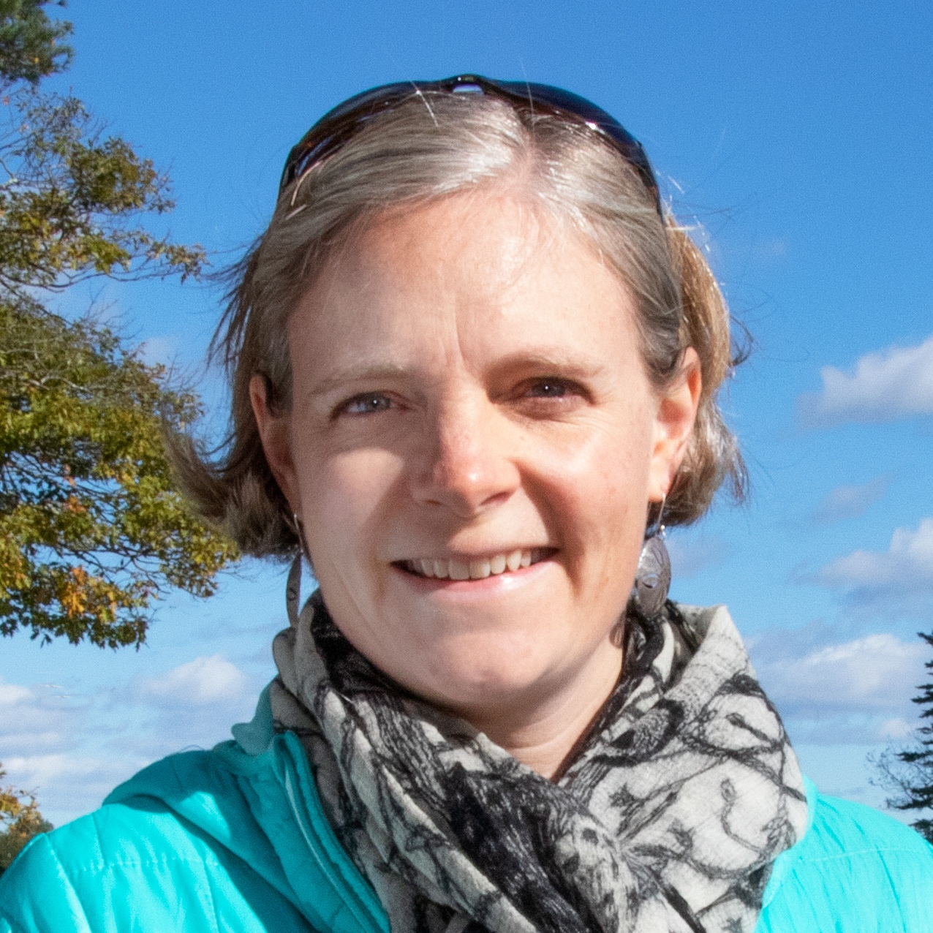
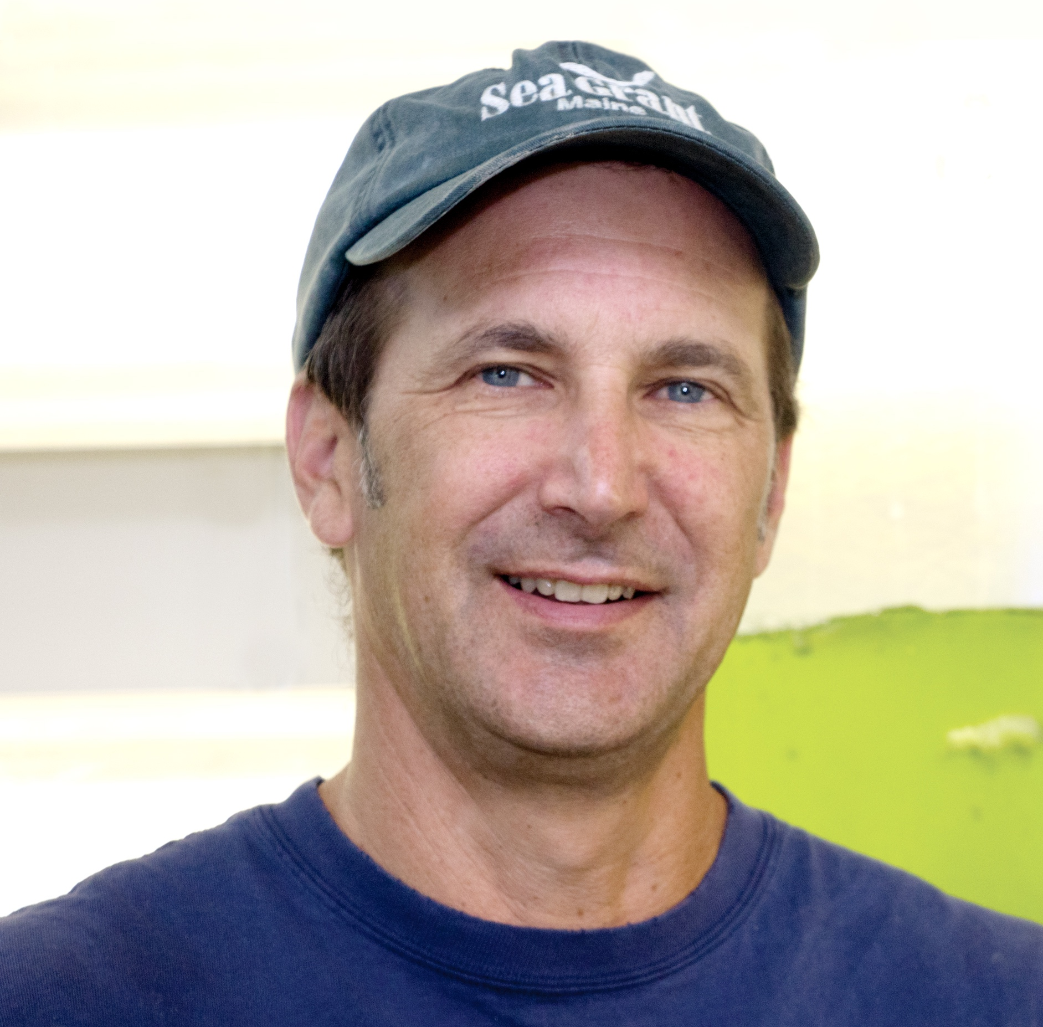
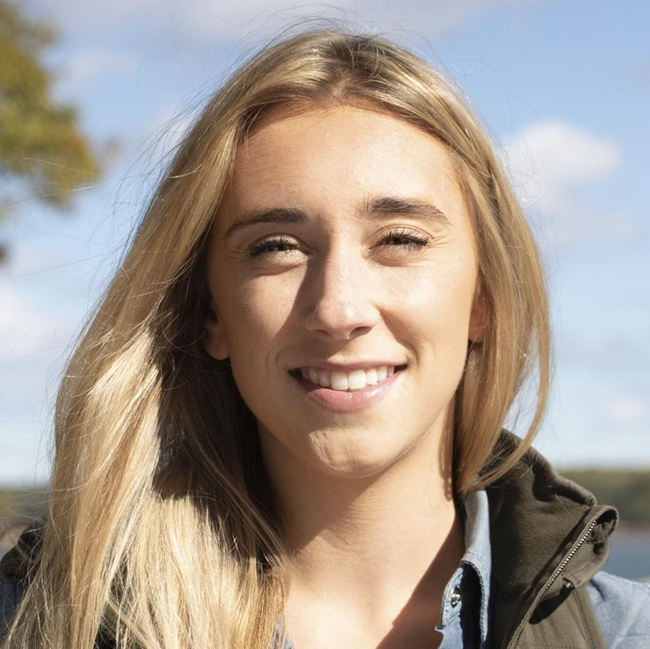
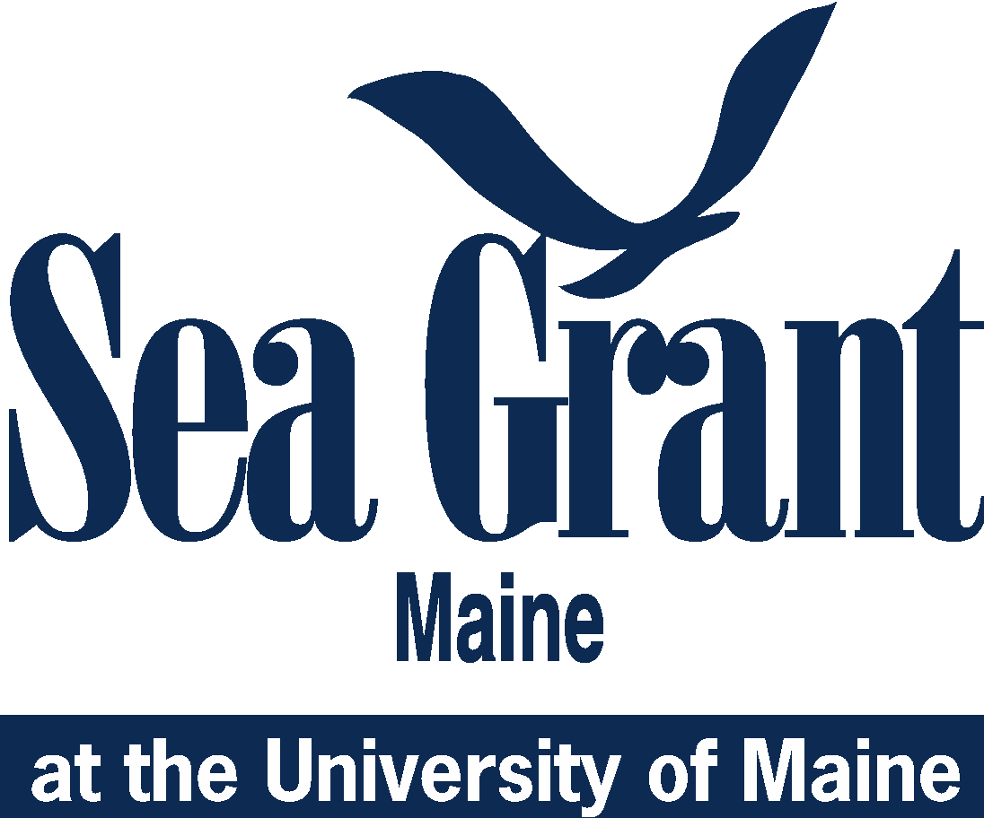
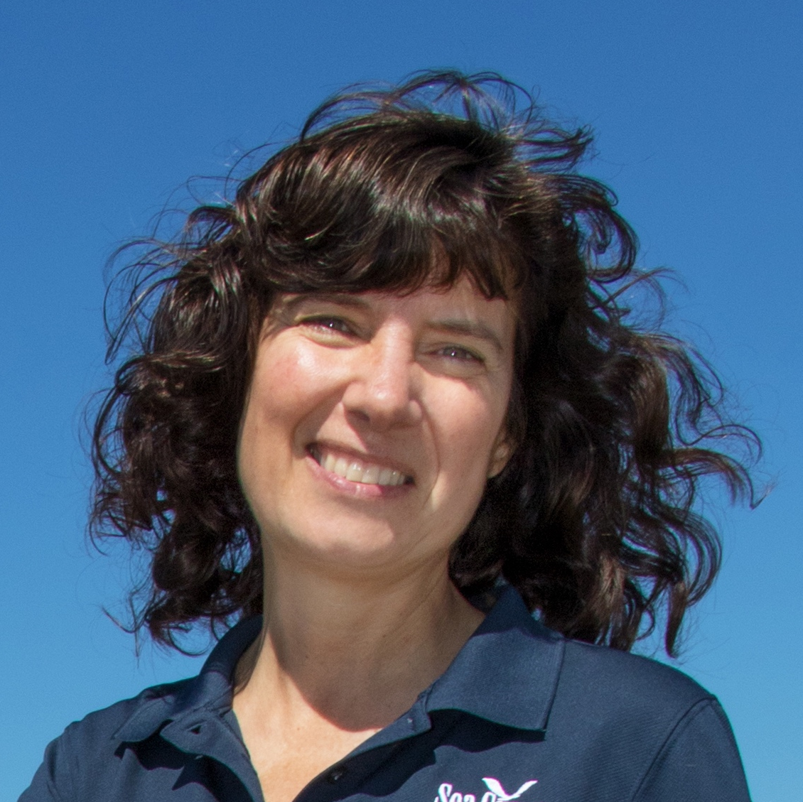
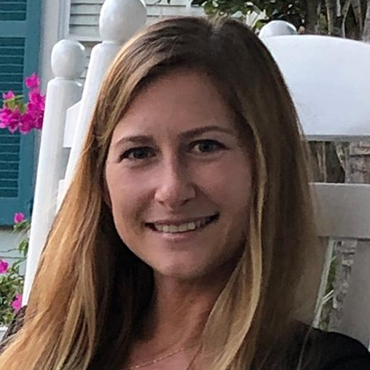
Orono
Eastport
Welcome to Maine!
Maine Sea Grant staff
and Marine Extension team are based at the University of Maine
in Orono and along
the coast…
Maine Sea Grant Teams
Management
Gayle Zydlewski
Justin Stevens
Extension
Lynn Wardwell
Communications
Jenny Spekhardt
Amalia Harrington
Kathy Tenga-González
Jessica Jansujwicz
Kathy Villarreal
Augusta
Hannah Robbins
Bar Harbor
Chris Bartlett
Waldoboro
Natalie Springuel
Brunswick
Walpole
Keri Kaczor
Esperanza Stancioff
Portland
Parker Gassett
Beth Bisson
Dana Morse
Jaclyn Robidoux
Wells
Heather Sadusky
Kristen Grant

Slide 3
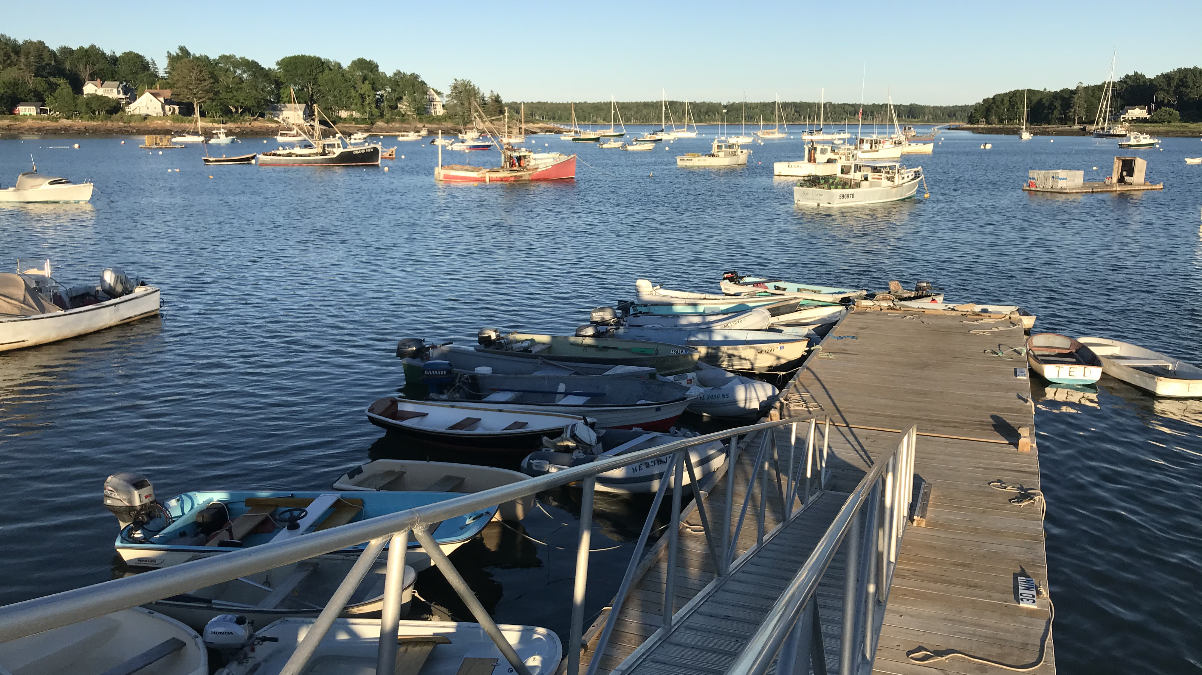
Resilient Communities and Economies
Measure: Number of communities that adopt/ implement sustainable economic and environmental development practices and policies as a result of Sea Grant activities

Slide 4
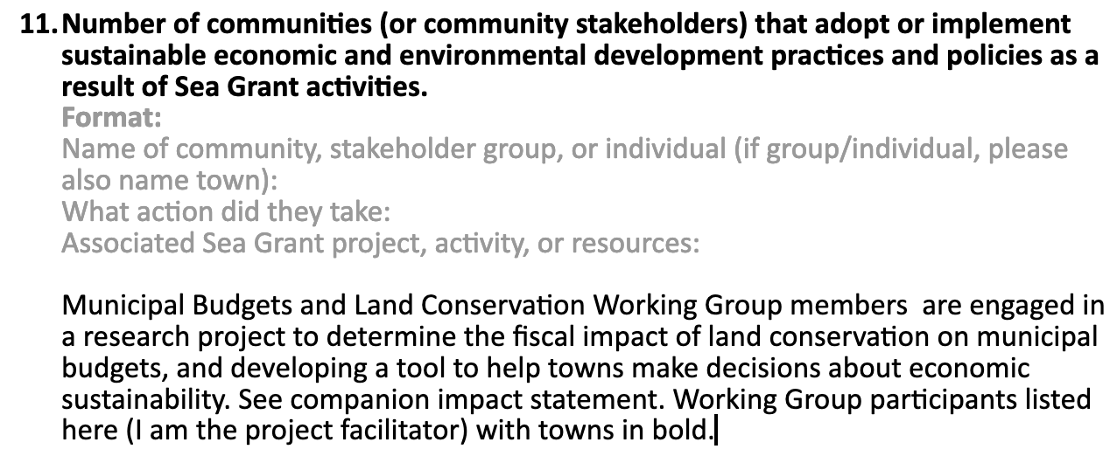
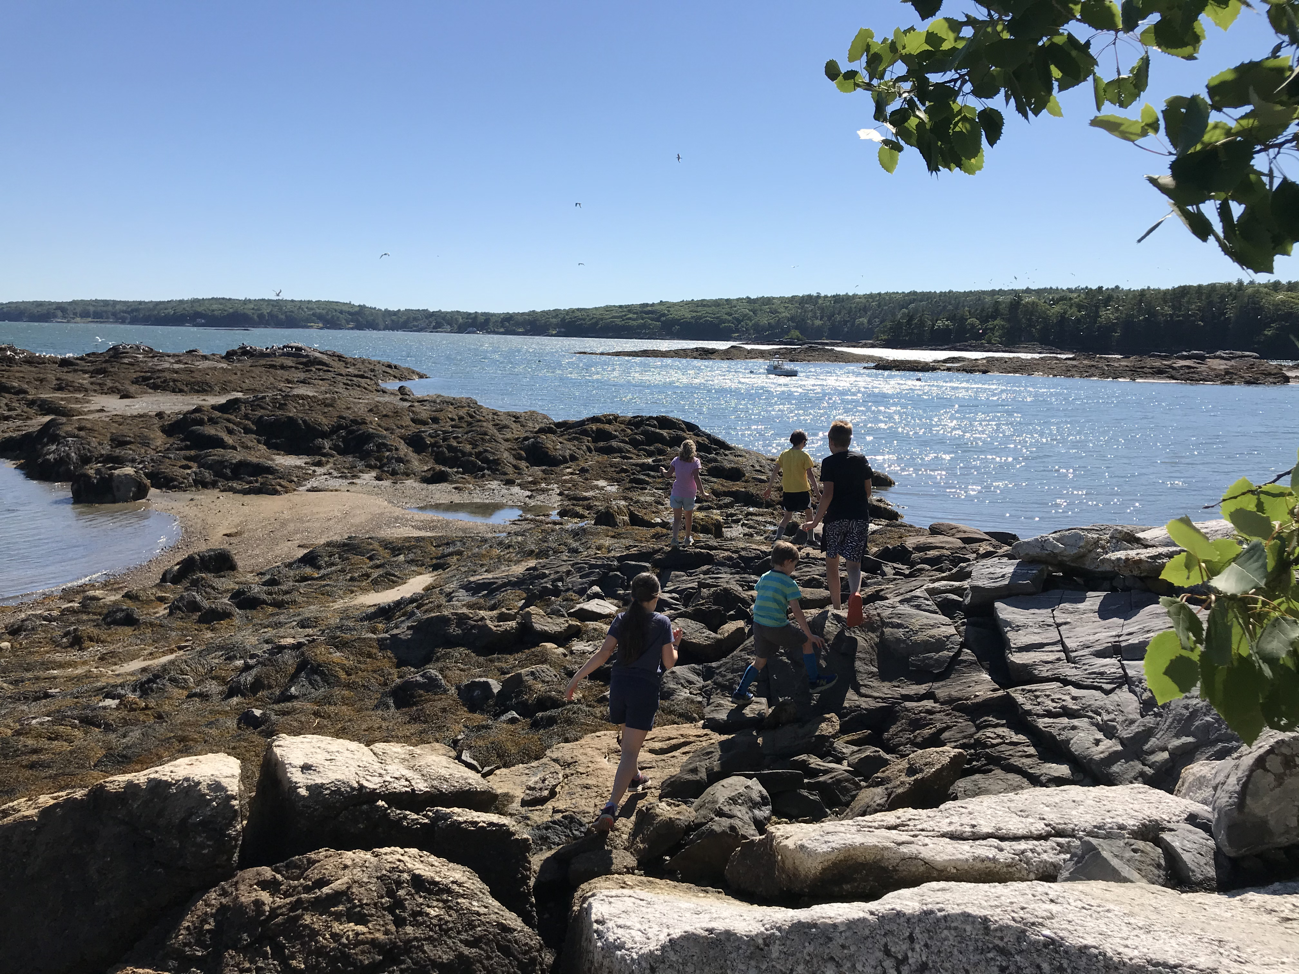
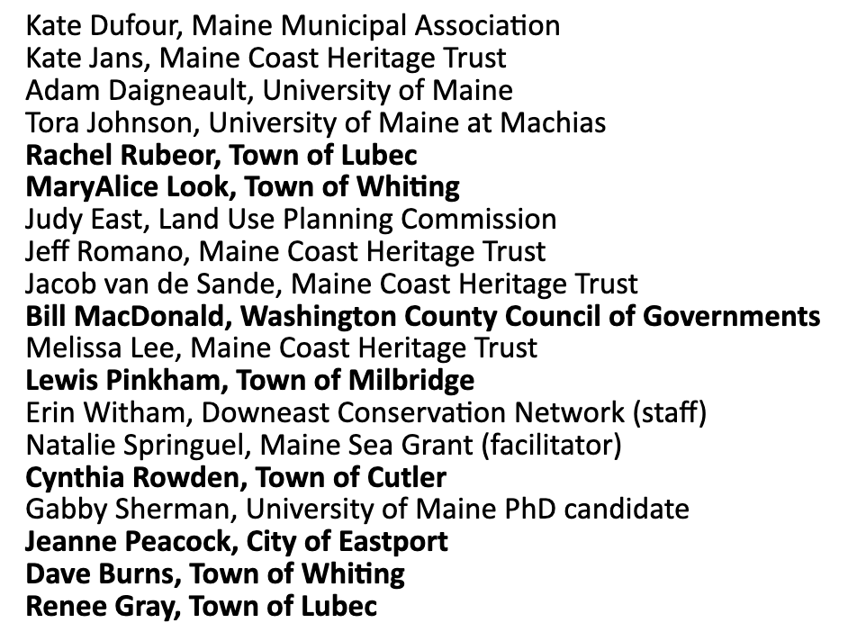
Step 1.
Compile Data from Staff and Research/PD Reporting Forms (using Google Docs)

Slide 5
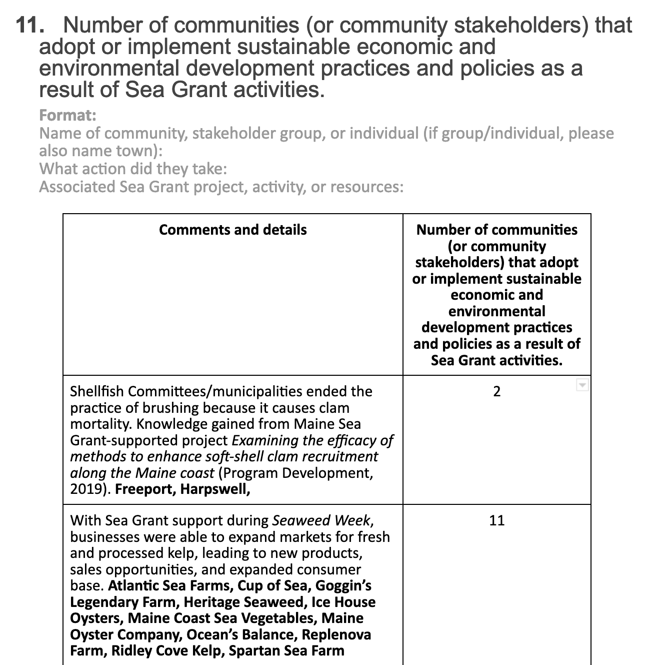
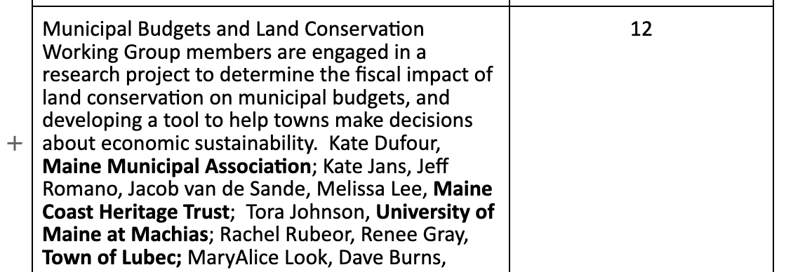
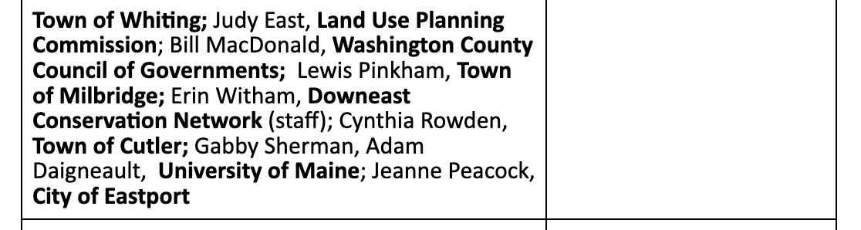
Step 2.
Tally examples

Slide 6
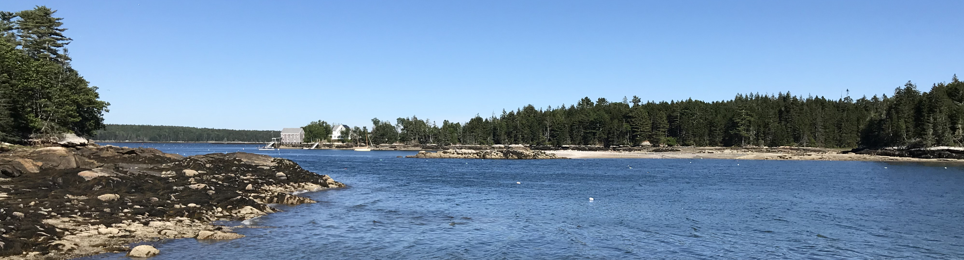
Step 3.
Summary text for PIER Comment Box:
Text for PIER:
NOTE: Maine Sea Grant includes community stakeholders (businesses, agencies, etc.) and Sea Grant-supported cross-sector partnerships that help communities to adopt/implement sustainable environmental practices and policies as part of this measure. (35) Atlantic Sea Farms, City of Eastport, Community Shellfish, Cooke Aquaculture, Cup of Sea, Downeast Conservation Network, Downeast Institute, Freeport, Georgetown Aquaculture, Goggin’s Legendary Farm, Harpswell, Heritage Seaweed, Ice House Oysters, Land Use Planning Commission, Luke’s Lobster, Maine Coast Heritage Trust, Maine Coast Sea Vegetables, Maine Municipal Association, Maine Oyster Company, Mook Sea Farm, Ocean’s Balance, Pemaquid Mussels, Ready Seafood, Replenova Farm, Ridley Cove Kelp, Spartan Sea Farm, Town of Cutler, Town of Lubec, Town of Milbridge, Town of Pembroke, Town of Perry, Town of Whiting, University of Maine, University of Maine at Machias, Washington County Council of Governments

Slide 7
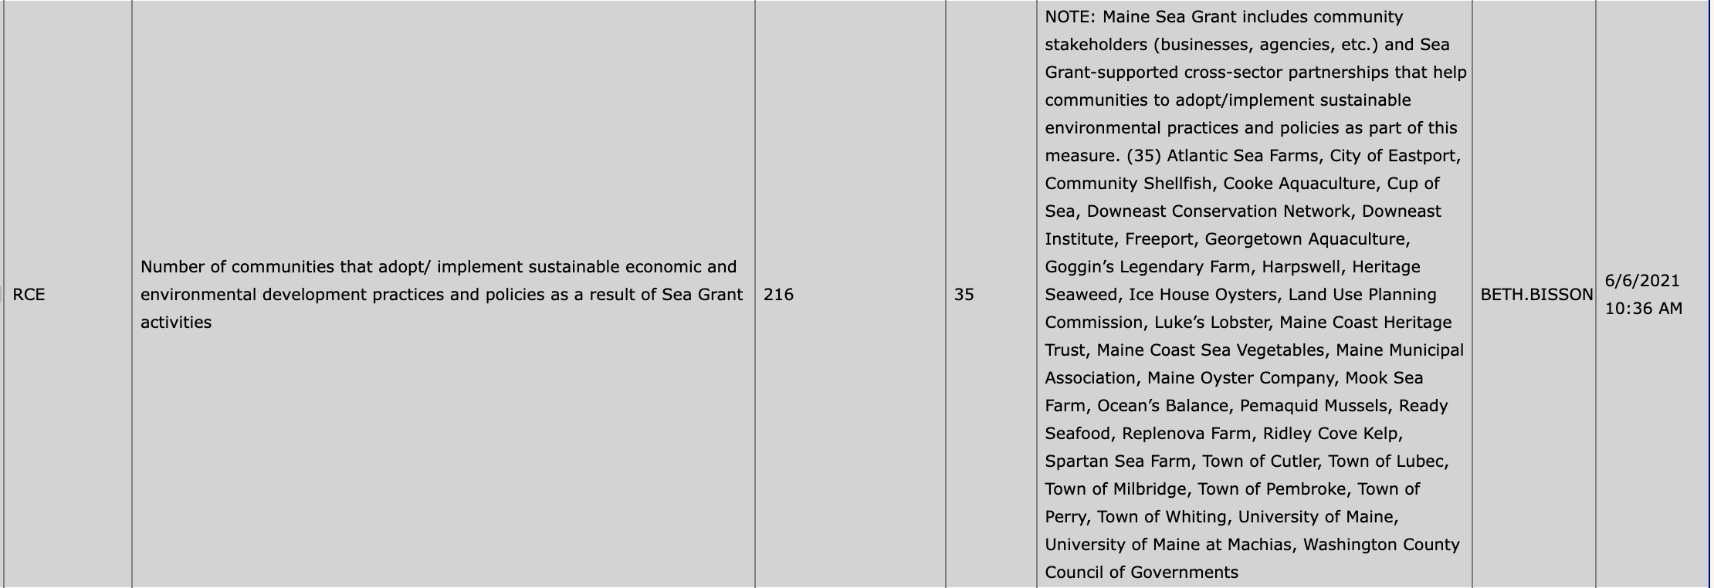
Step 4.
Enter to PIER

Slide 8
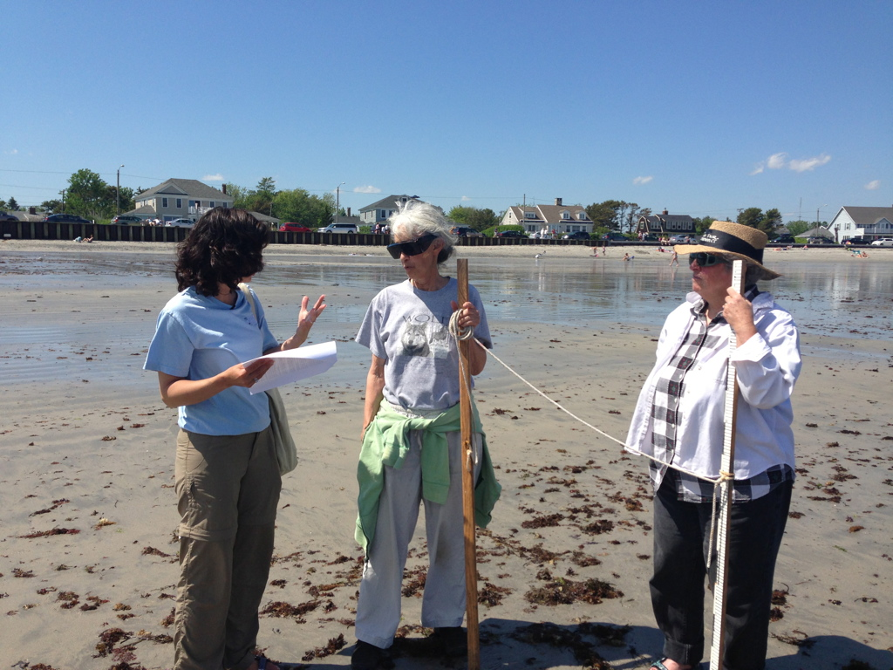
Resilient Communities and Economies
Measure: Number of coastal communities that have adopted or implemented hazard resiliency practices to prepare for and respond to/minimize coastal hazardous events.

Slide 9
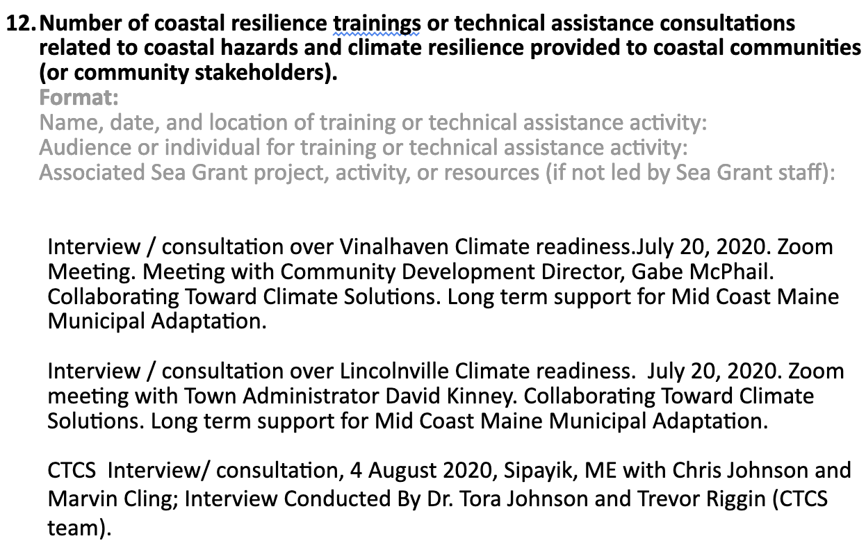
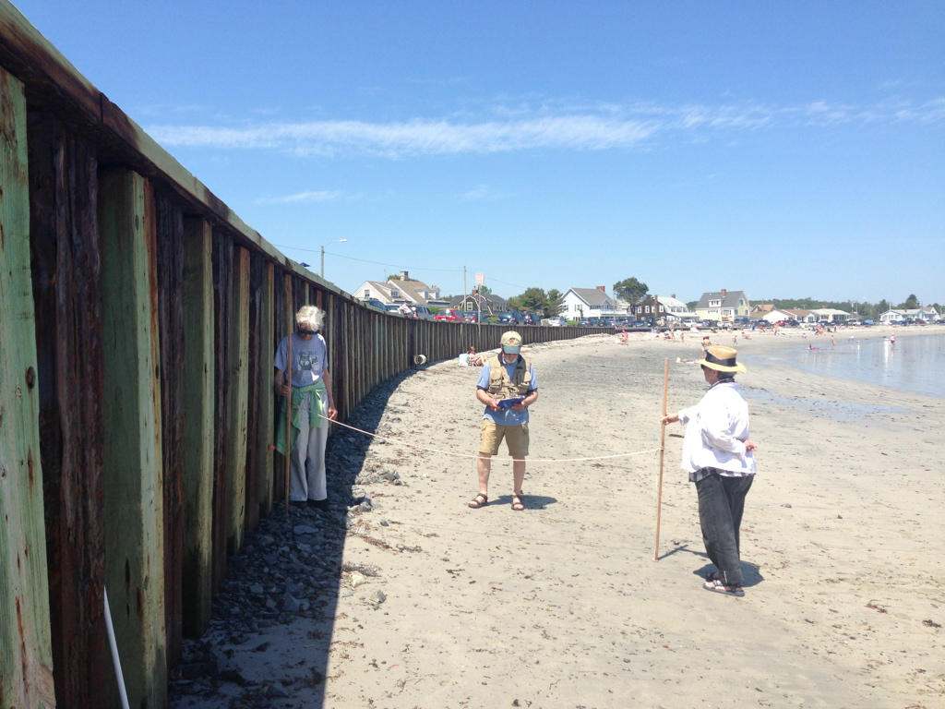
Step 1.
Compile Data from Staff and Research/PD Reporting Forms (using Google Docs)

Slide 10
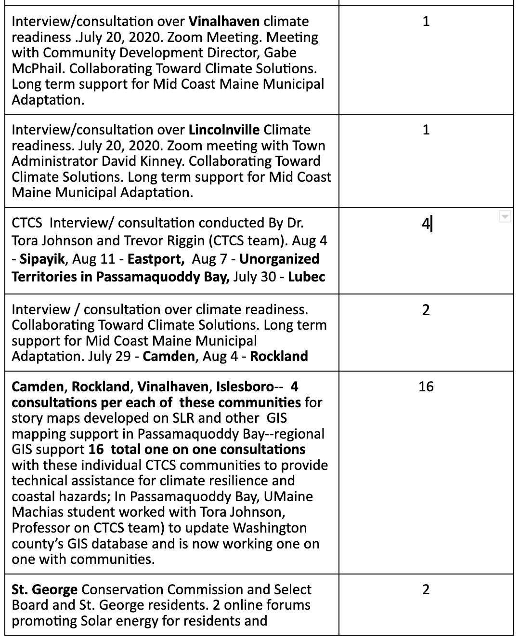
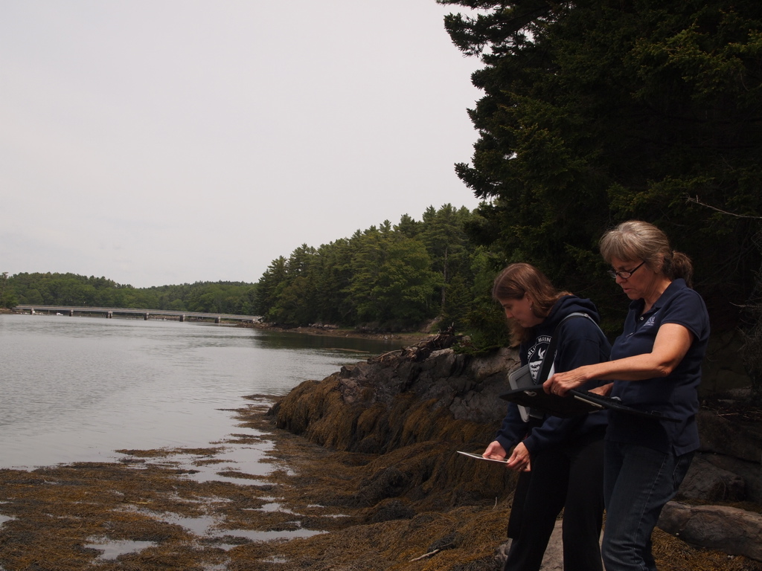
Step 2.
Tally examples

Slide 11
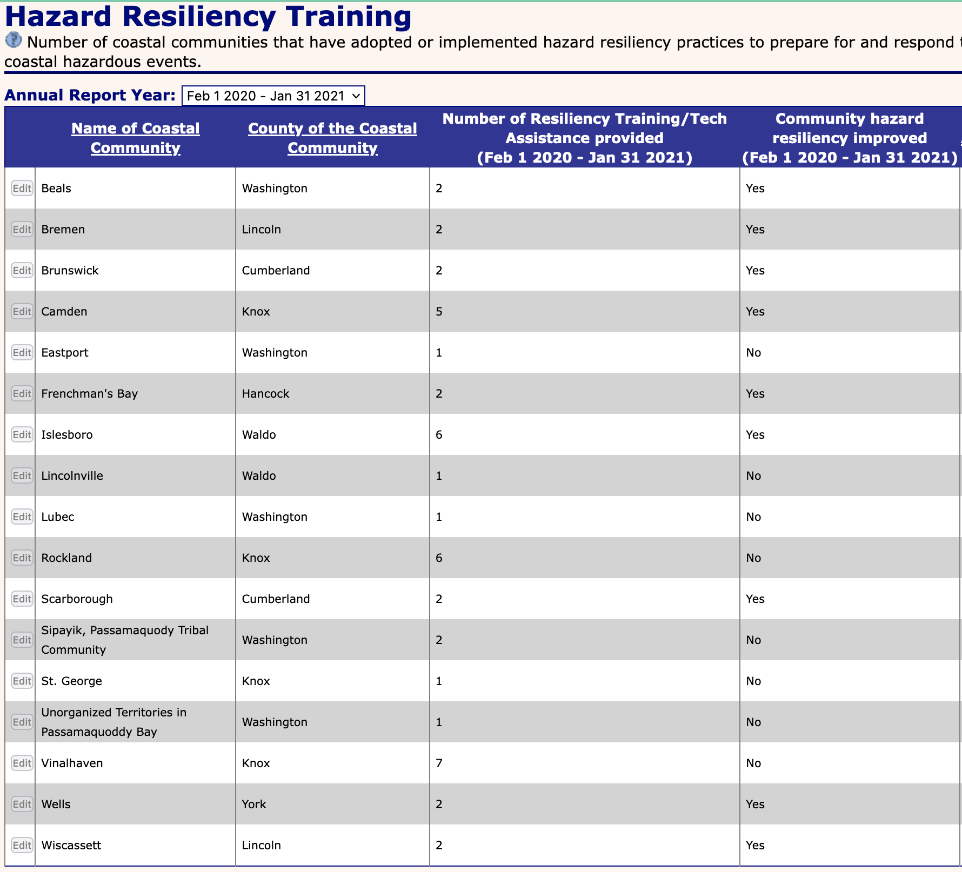
Step 3.
Enter Data to PIER*
*involves identifying:
Number of trainings in each community
County of each community
Whether or not hazard resiliency was improved (need additional info)

Slide 12
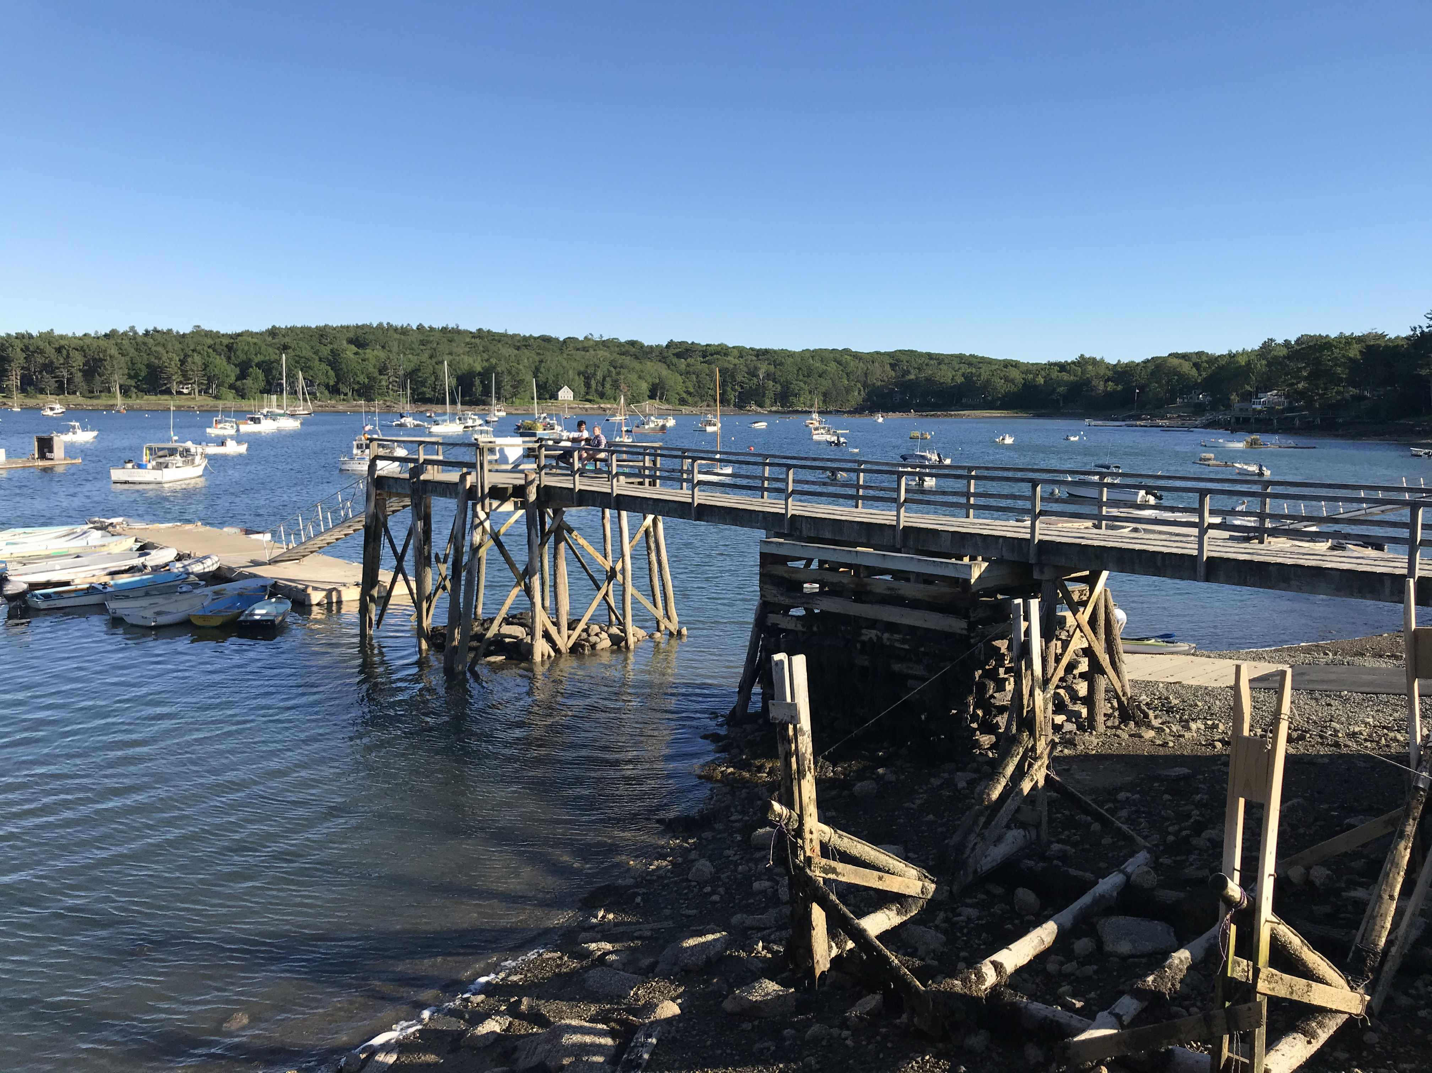
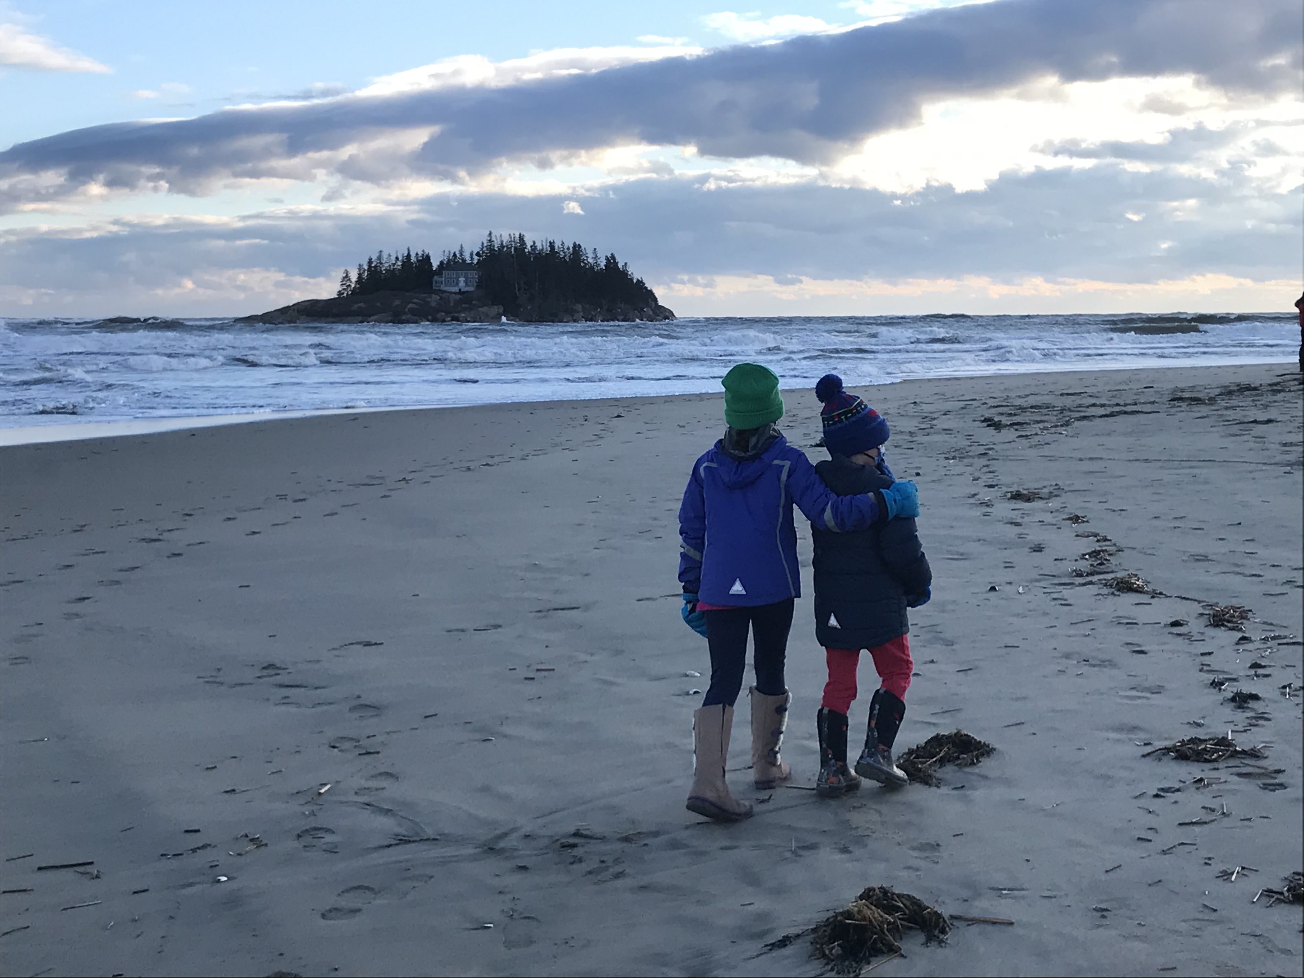
Questions?
beth.bisson@maine.edu
hannah.robbins@maine.edu

