Slide 1
Leveraged Funding Reporting
UF Sources
Non-UF Public Sources
Managed
Non-UF Private Sources
Researchers
Marine Agents & Specialists
Agency & Organization Partnerships
Influenced
Charles Sidman Florida Sea Grant

Slide 2
Leveraged Funding
Topics Covered
Types & Guidance
Examples
Tracking (OARS)
Reporting (PIER)
Tips

Slide 3
Leveraged Funding
Types & Guidance
Managed
Host institution (UF-based) internal funds managed by the program.
Non-UF based external funds managed by the program.
Influenced
External funds leveraged by core FSG programming but not managed by the program.
Guidance
Leveraged funds can not come from or flow through the NSGO or NOAA.
Leveraged funds can not be used for match on the OMNIBUS grant.

Slide 4
Leveraged Funding
Examples
Managed – UF and Outside Funding Sources
Funds can not be used for match on OMNIBUS grant
UF appropriations
UF IDC return
Investigator Residual Funding
UF Foundation
Endowments
HACCP
Coral Reef (FWC) and Clean Vessel (DEP) Coordinators.
Influenced – Funding Derived from SG Funding
Research grants obtained by FSG funded agents, specialists and researchers that do not flow though Sea Grant or are from non-NOAA sources.
Ocean Conservancy
The Nature Conservancy
Florida DEP; FWC; FDACS; WCIND
Program administrative actions can also lead to managed and influenced funding through endowments, contracts and grants.

Slide 5
Leveraged Funding
Tracking
Collaborative activity involving fiscal, research and extension administration.
Facilitated by fiscal department funding source tracking system and research project/extension activity reporting.
Fiscal Department- Tracks leveraged funding managed by the program (funding sources and amounts)
Research Program – Tracks funding influenced by program researchers and affiliates (OARS)
Extension Program – Tracks funding influenced by program agents and specialists (OARS)

Slide 6
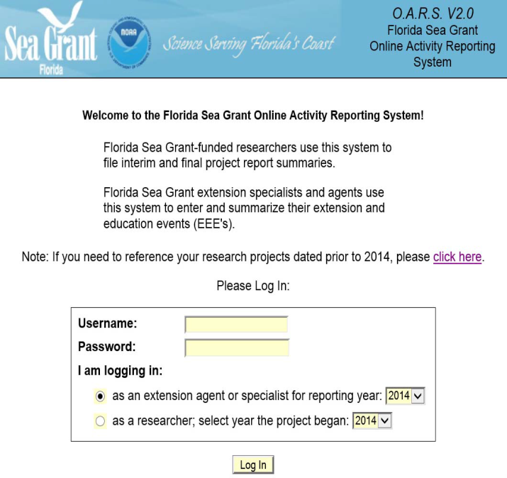
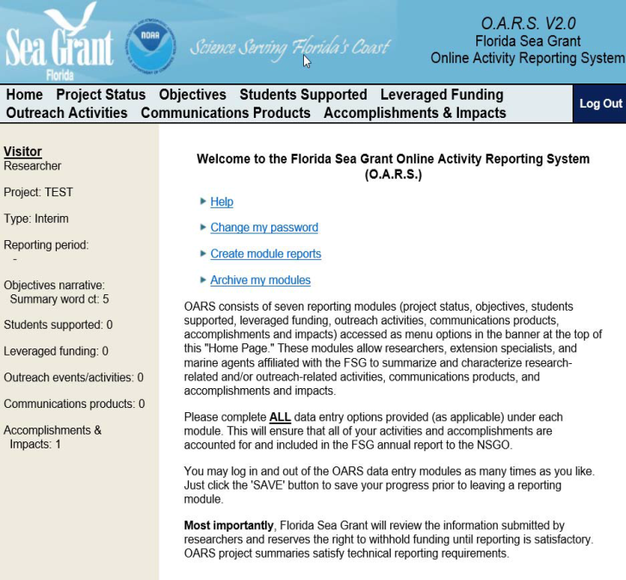
Leveraged Funding
Tracking
Online Activity Reporting System (OARS)
Home Page
Login Page
Notes:
Access if password protected. Reporting modules are available to researchers and extension faculty. There are 8 reporting modules developed to align with the needs of the PIER reporting system.

Slide 7
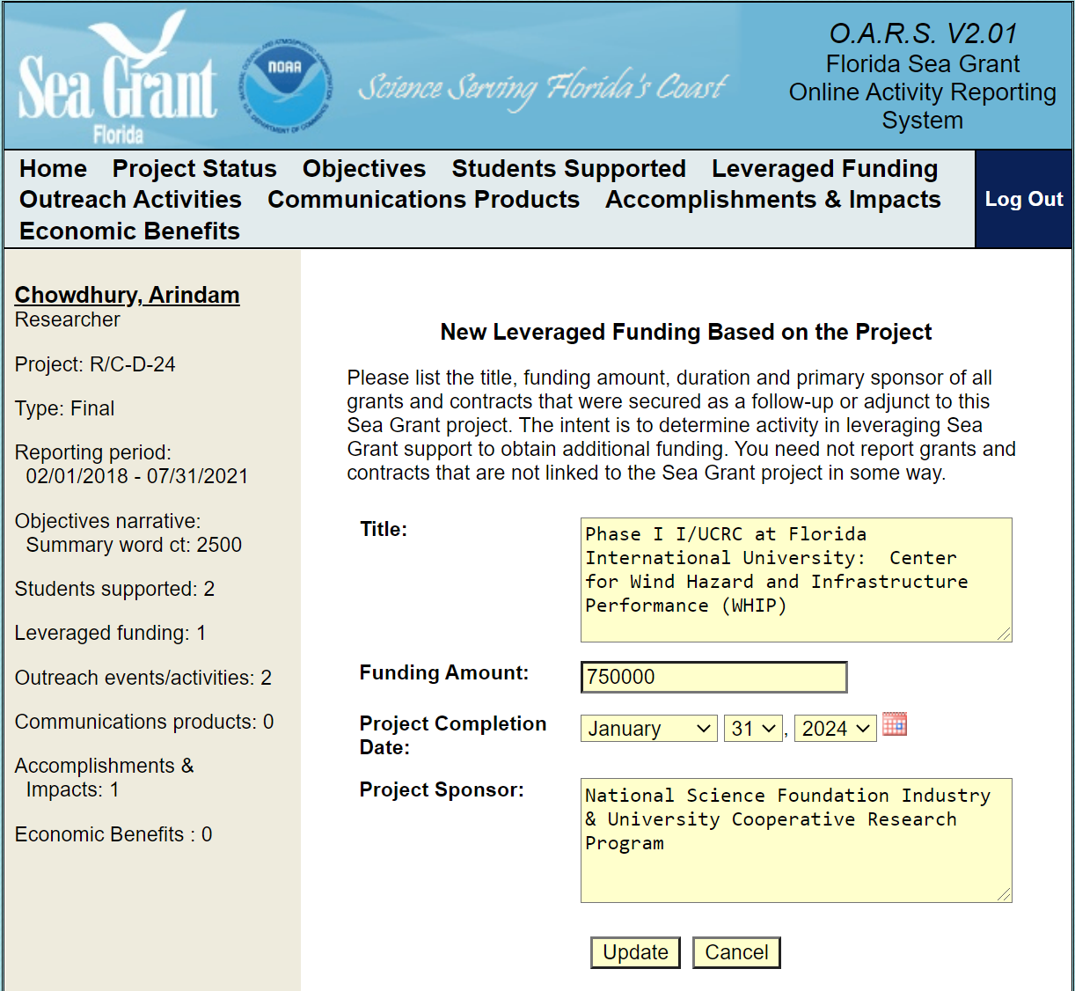
OARS Leveraged Funding Module
Tracking Leveraged Funding

Slide 8
Reporting
OARS
PIER

Slide 9
Leveraged Funding
Tips
Each program has a unique arrangement with their host university or institution, which influences the kinds of funds that are available to be reported as leveraged.
We recognize individual and collaborative contributions towards accurate and complete program, project and activity reporting.
“Best Intentions Award”
At our annual program meeting we present OARS awards for individual and collaborative program reporting.
“Most Impactful Impact”
“Outstanding
Outreach
Program”
“Extramural
Funding
Success”
“Exemplary Activity Reporting”
“Best Communications Product"

