Slide 1
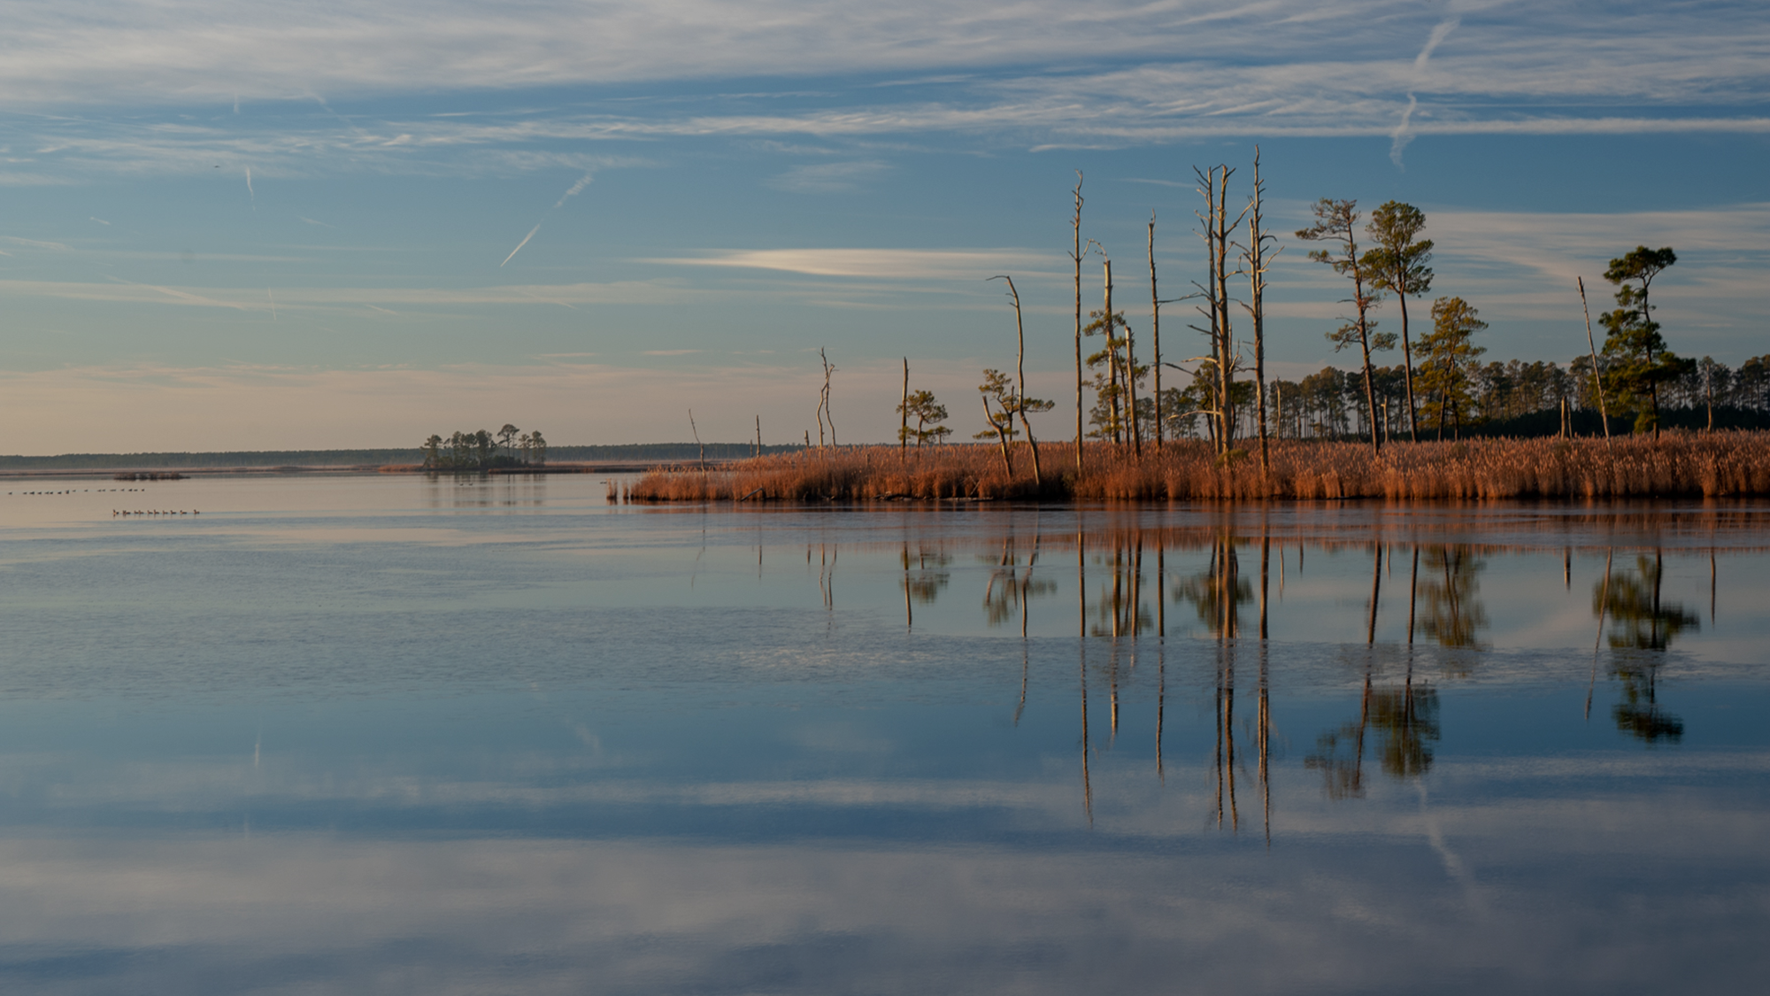
Sea Grant Products: ELWD and EBM Tools and Technologies
Mike Allen, Associate Director
Sea Grant Collaborative Reporting Meeting
February 1, 2022

Slide 2
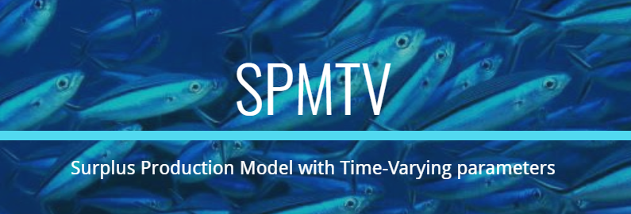
Performance Measures
Number of Sea Grant tools, technologies and information services that are used by our partners/customers to improve ecosystem-based management.
Number of Sea Grant products that are used to advance environmental literacy and workforce development.

Slide 3
Process and Timeline
August - September | Annual Report Call for omnibus projects*
October | Annual Reports due to Sea Grant (eSeaGrant)
November | Annual Reports reviewed/edited for RPPR submission
January | Impact statement decisions and interviews start
April | All PM data downloaded from eSeaGrant
May | Impact statement drafts reviewed for additional tools and language Tool decisions finalized and language drafted
June | Final tool descriptions entered into PIER

Slide 4
Annual Report eSeaGrant
PIs submit narrative elements and respond to various performance measures and other requirements
Draft doc and instructions
Research director reviews each of the annual reports for project progress, potential impact statements, performance measure and metric accuracy and makes corrections
Maintain report by report notes
Annual report finalized for submission with RPPR by Nov 30
Notes:
On the right-hand side, see the different elements we include in our annual report in eSeaGrant.
Reports are generally due in mid-October, though that can vary depending on the start date.

Slide 5
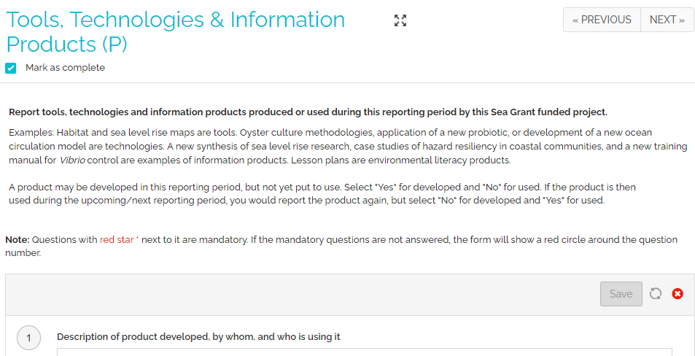
Notes:
We use this form to collect information on both tools and technologies for EBM and environmental literacy products.
PIs are provided the instructions above.
Form aligns with the questions from PIER and provides us with extra information to write up a summary.

Slide 6
Products Form Questions
Check this box for books, one-pagers, websites, lesson plans, videos and anything else that might be considered outreach or education materials.
Description
Environmental Literacy?
EBM?
Developed?
Used?
How many people?
Partner names
Notes:
Form aligns with the questions from PIER and provides us with extra information to write up a summary.

Slide 7
Many environmental literacy products captured here
Highlight in review of report, or add in “Tools and Technologies” form

Slide 8
eSeaGrant Excel Output

Slide 9
Importance of Impact Statements
Review annual reports / selection target projects
Assignment to staff member
PI interviews
Drafting / editing
Incorporation into widgets / cross-check
Notes:
Fact checking, additional context from the annual report, dissemination and scope of impact of the work.

Slide 10
eSeaGrant Excel Output

Slide 11
Example Description Tool
Developed, not disseminated or used
R/AQ-10: Three triploid lines derived from Maryland low-salinity waters, one disease resistant diploid line and one low-salinity diploid line were produced by Sea Grant researchers and an extension specialist. They are being developed for use in Maryland by the aquaculture industry.
Relevant Information
Project ID
Who created the product
What was the product
How was it disseminated
Who used the product
What were the impacts/outcomes

Slide 12
Example Description Environmental Literacy
Developed, disseminated, used
A/EX-1: MDSG Extension published several factsheets and videos on septic system best practices which have been shared with participants and NGOs. Paired with outreach webinars and video recordings, the products have led to implementation of septic maintenances practices and best available technology upgrades by homeowners who were surveyed.
Relevant Information
Project ID
Who created the product
What was the product
How was it disseminated
Who used the product
What were the impacts/outcomes

Slide 13
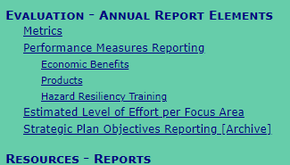
PIER Data Entry

Slide 14
PIER Data Entry
MDSG’s 2021 Summary
12 Products
9 ELWD
3 EBM
12 “Developed”
6 “Used”

Slide 15
Summary of MDSG Practices
Collect initial information from PIs in annual report
Verify and elaborate on PI input
Select best products to include
Use a mini-summary statement to explain product and demonstrate its use

Slide 16
Questions?
Padlet: https://padlet.com/maboyce2/108sykn6b38qb751
Notes:
https://padlet.com/maboyce2/108sykn6b38qb751

